Slide 1

Safety in lab
CHEMICAL RISK ASSESSMENT AND MANAGEMENT

Slide 2
Hazard
Hazard: inherent properties of some factor (objects, substances, machines, etc.) having the possibility to cause an injury.
Hazard is an intrinsic property of the specific factor;
All the warnings in the User’s Guide concern the hazards

Slide 3
Risk
Risk: It is the likelihood that a hazard will actually cause its adverse effects, together with a measure of the effect.
Risk concern about the probability that the hazard will provoke its adverse effect, weighted with the magnitude of the damage

Slide 4
Risk assessment
The risk dimensions depend on:
  The probability that the damage will happen;
  The entity of the damage, that could be of different gravity.

Slide 5
Risk definition
P = Probability of occurrence (frequency)
M = Entity of the damage (magnitude)

Slide 6
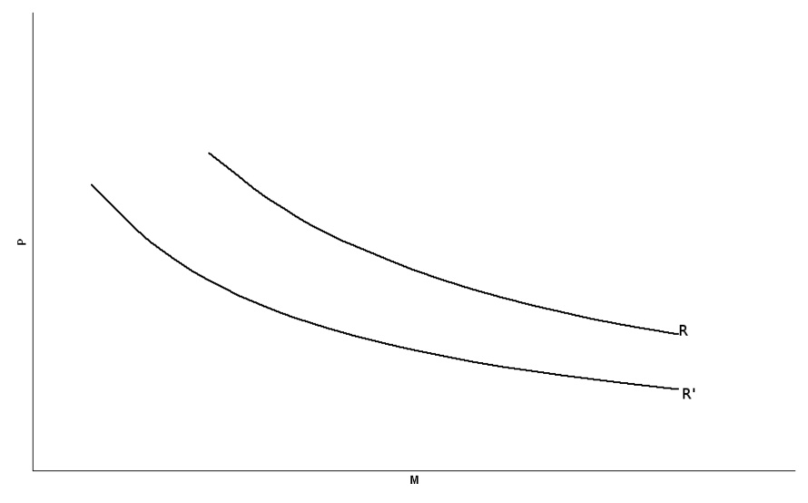
Risk reduction
To minimize the risk entity we can work on:
  P: prevenction
  M: protetection
K is an attenuaction factor

Slide 7
Risk management
Risk assessment and risk management are closely related but different processes, with the nature of the risk management decision often influencing the scope and depth of a risk assessment.
In simple terms, risk assessors ask “How risky is this situation?” and risk managers then ask “What are we willing to accept?” and “What shall we do about it?” Risk assessment is usually seen as the objective/scientific part of the process and risk management as the subjective/political part.

Slide 8
Risk management
The conventional wisdom – which needs rethinking - is that risk management should not influence the processes and assumptions made in risk assessment: the two functions should be kept conceptually and administratively separate.
Risk assessment provides information based on the analysis
of scientific data which describe the form, magnitude, and characteristics of a risk, i.e. the likelihood of harm to humans or the environment.
Although risk assessment is mainly a scientific task, political decisions are required on matters such as: “What are we trying to protect and to what extent should it be protected?” Endpoints, unacceptable effects, magnitude of uncertainty factors are controversial topics and based on implicit political
choices. Questions about risk often have no scientific answers or the answers are multiple and contestable.

Slide 9
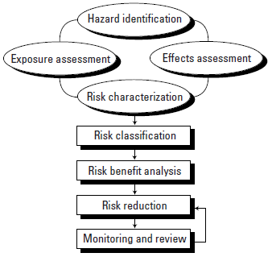
Risk management

Slide 10
Risk management
Step 1) Hazard identification:
Hazard identification is the identification of the adverse effects that a substance has an inherent capacity to cause. It is the likelihood of harm due to exposure that distinguishes risk from hazard.
Hazard identification involves gathering and evaluating data on the types of health effects or disease that may be produced by a chemical and exposure conditions under which environmental damage, injury or disease will be produced. For example, a toxic chemical that is hazardous to human health does not constitute a risk unless humans are exposed to it.
Hazard identification may also involve characterization of the behaviour of a chemical within the body and its interactions with organs, cells, or genetic material. The principal question is whether data from populations in which toxic effects and exposure occur suggest a potential problem for other populations under similar exposure conditions.

Slide 11
Risk management
Step 2) Exposure assessment:
Exposure can be assessed by measuring exposure concentrations, once chemicals are produced, used and emitted. With new chemicals, exposure assessments can only be predictions. This involves estimating emissions, pathways and rates of movement of a substance and its transformation or degradation in order to obtain
concentrations or doses to which human populations or environmental compartments are or may be exposed.
In health risk assessment the various exposure routes are often combined in order to determine a total daily intake, expressed as mg per kg body weight per day. In ecological risk assessment there is no single predicted environmental concentreation or total daily intake, in fact, there are many of these.

Slide 12
Risk management
Step 3) Effects assessment:
Effects assessment or, more precisely, dose-response assessment, is the estimation of the relationship between dose or level of exposure to a substance, and the incidence and severity of an effect.
It sometimes involves the description of the quantitative relationship between the degree of exposure to a substance and the extent of a
toxic effect or disease, but reliable quantitative precision cannot always be achieved.
Data are generally obtained from (quantitative) structure-activity relationships, read-across and in vitro studies or from experimental animal laboratory studies or epidemiologic studies of human populations or combinations of these.

Slide 13
Risk management
For most chemicals, no effect levels (NELs) derived from studies in laboratory animals are converted into predicted or estimated NELs (PNELs or DNELs) for humans by applying assessment
factors usually in the range of 10-10,000.
Assessment factors are numbers reflecting the estimated degree or amount of uncertainty when experimental data from model systems are extrapolated to humans. The rationale for assessment factors is
that if no assessment factors are applied large groups of the human population or large parts of ecosystems will remain unprotected.

Slide 14
Risk management
Step 4) Risk characterization:
Risk characterization is the estimation of the incidence and severity of the adverse effects likely to occur in the human population due to actual or predicted exposure to a substance, and may include risk estimation, i.e. the quantification of that likelihood.
A framework to define the significance of the risk is developed, and all the assumptions, uncertainties, and scientific judgements from the preceding three steps are considered. In many international regulatory frameworks environmental risks are often expressed as PEC/PNEC ratios, i.e. as risk quotients. For human risks a similar comparison between exposure and the NEL is usually made. It should be noted that these ratios or comparisons provide no absolute measure of risks. Nobody knows the real risks of chemicals where the exposure exceeds the PNEC or NEL. We only know that the likelihood of adverse effects increases as the exposure/effect level ratios increase. Thus, exposure/effect ratios are internationally accepted substitutes for risks. It should also be noted that there is no such thing as precise risk assessments and scientists will always differ in the conclusions they draw from the same set of data, particularly if they contain some implicit value judgements.

Slide 15
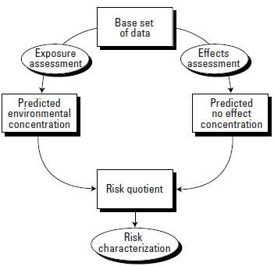
Risk management

Slide 16
Risk management
Step 5) Risk classification:
Once a risk characterization has been made the focus turns to risk management. The first step in the risk management phase is the classification, i.e., the valuation of risks in order to decide if risk reduction is required. It is obvious that risks cannot be evaluated solely on the basis of scientific considerations, but who can decide what is acceptable? Decisions about risk classification are related
to risk acceptance and must always be taken in a situation of some residual uncertainty. This is the field of policymakers.
The term “acceptability” has become a crucial new element to be considered as a constituent part of the risk management process. It is important to realize that discussions on acceptability go back to our roots: to our youth, education and culture. In conclusion: risk classification is related to risk acceptability, which in turn is a risk-related, technical, social, cultural, political, educational and economic (conjuncture-dependent) phenomenon.

Slide 17
Risk management
Over the past decade there has been growing support for defining two risk levels that may help to avoid lengthy debates about acceptability, because the area under discussion is restricted. These risk levels are known as:
• The upper limit, i.e. the maximum permissible level (MPL).
• The lower limit, i.e. the negligible level (NL).
These two risk limits create three zones: a black (high risk) zone, a grey (medium risk) zone and a white (low risk) zone.
Actual risks in the black zone above the MPL are unacceptable and further risk management measures (RMMs) are necessary. Actual risks in the white zone below the NL (the de minimus level) are “low for safety and irrelevant to the health of workers” and further RMMs are not strictly required.

Slide 18
Risk management
In the grey zone between the upper and lower limits, risk reduction is required based on the ALARA principle (as low as reasonably achievable). This is a powerful risk management principle.
Managers are expected to do everything possible to reduce risks up to a limit they can justify to their organization and justify to the regulatory authorities.
In general, the aim is to reduce risks until the cost of doing so is disproportionate to the benefit.

Slide 19
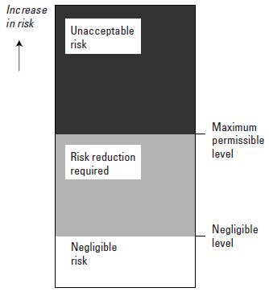
Risk management

Slide 20
Risk management
Step 6) Identification and risk-benefit analysis of risk reduction options:
Once risk classification has been completed and risk reduction is thought necessary, the next consideration is the identification and analysis of options for risk reduction, and eventually selection of the most appropriate risk reduction option(s).
The options for the risk reduction of chemicals range from slight adaptation of the production process or the intended use of the
chemical to a complete ban on the production or use of a chemical.
To that end a risk-benefit analysis sensu lato is carried out by drawing up of a balance sheet of the respective risks and benefits of a proposed risk-reducing intervention as compared to the baseline, i.e. the situation of not imposing risk reduction.

Slide 21
Risk management
Once risk classification has been completed and risk reduction is thought necessary, the next consideration is the identification and analysis of options for risk reduction, and eventually selection of the most appropriate risk reduction option(s).
The options for the risk reduction of chemicals range from slight adaptation of the production process or the intended use of the
chemical to a complete ban on the production or use of a chemical.
To that end a risk-benefit analysis sensu lato is carried out by drawing up of a balance sheet of the respective risks and benefits of a proposed risk-reducing intervention as compared to the baseline, i.e. the situation of not imposing risk reduction.

Slide 22
Risk management
Selecting risk-reducing options will trigger “acceptability” discussions, not only about the predicted risks themselves but also about the anticipated consequences of risk reduction measures. This requires risk communication: a process by which stakeholders
discuss risks and consequences with one another. Because the perception of risks often differs widely, risk communication typically requires a sensitive approach and should involve genuine dialogue.
In conclusion, selecting the options for risk reduction using risk-benefit analysis is a multifaceted task centering on discussions about acceptability. Acceptability revolves around facts, value judgements and communication. It is this part of the risk management process in particular, where the lines between science, science policy and policy become fuzzy, that much conflict arises over where the boundary should be drawn.

Slide 23
Risk management
Step 7) Risk reduction:
Risk reduction is taking measures to protect humans and/or the environment against the risks identified.
1. Classification and labelling
Notifiers of chemicals are required to provisionally classify and label dangerous substances on the basis of the intrinsic properties of the chemical. The decision on how to classify and label a substance is based on a series of criteria which themselves are based on the results of standard laboratory tests. The classification and labelling
includes assigning a pictogram, a hazard statement and a precautionary statement. Classification and labelling can be considered to be the first risk management tool for chemicals.

Slide 24
Risk management
2. Safety standards
Safety or quality standards are another approach to chemicals control. Such standards are set with the intention of protecting human health.
The terms criteria, guidelines, objectives, and standards, are often used. In this sequence the nature of the values moves from recommendations towards legally binding provisions. The use and interpretation of these terms varies between different agencies and countries. These terms are defined as follows:
• Criteria are quality guidelines based on the evaluation of scientific data.
• Guidelines are numerical limits or narrative statements that are applied to protect human health.
• Objectives are numerical limits or narrative statements that have been established to protect and maintain human health.
• Standards are fixed upper limits of exposure for certain chemicals that are laid down in enforceable laws or regulations by one or more levels of government.

Slide 25
Risk management
3. Risk reduction measures (sensu proprio)
RMMs may comprise:
• Technical measures such as redesign of production and use processes, closed systems, separation of man and sources (by construction measures), exhaustion, ventilation, separation and clarification techniques, physical, chemical and biological treatment.
• Organizational measures such as restriction to certain specific workplaces, limiting time of operation or work activities, training, monitoring and surveillance, prohibiting eating, drinking and smoking at the site.
• Instructions, information and warnings regarding normal use or safe use. This may include classification and labelling as described above.
• Personal protection measures such as gas and dust filter masks, independent air equipment, goggles, gloves and protective clothing.
• Product-substance related measures. Examples include limiting the concentration of a substance in a preparation or article.
• Instructions to limit the use of a substance or product. This can be implemented by limiting certain applications and uses and the restriction of uses with releases, etc.

Slide 26
Risk management
Step 8) Monitoring and review:
Monitoring and review is the last step in the risk management process. Monitoring is the process of repetitive observation for defined purposes of one or more chemical or biological elements according to a pre-arranged schedule over space and time, and using comparable and preferably standardized methods. Monitoring is undertaken to ensure that previously formulated standards are being met.
Besides monitoring there are many other ways to review health management measures such as: audits and inspections, voluntary
agreements and programmes, reporting (e.g. in case of voluntary agreements), market investigations, economic instruments, product registers, technology assessments, performance measurements and indicators for human health and sustainable development. These are equally important tools used to arrive at sustainable patterns of production, use and disposal of chemicals.

Slide 27
Risk management
While in the past the entire risk management process was the responsibility of authorities (except for the implementation of risk reduction), the responsibility has now shifted to industry (manufacturers and importers in collaboration with their downstream users). Furthermore the focus has changed from risk assessment to risk management. These are fundamental changes by which the main policy objectives of REACH are achieved, i.e., the reversal of the burden of proof from the authorities to industry for testing and risk assessment and a shift in the focus on identification and implementation of risk management measures to controlling the risks of chemicals. In this way REACH could be considered a legal instrument for implementing “responsible care”.
Now, under the REACH legislation emphasis is placed on industry taking its own responsibility for the safe use of chemicals. This will take the form of a formal requirement to draw up exposure scenarios. These scenarios will be used as a tool to indicate what risk management measures (RMMs) will be used under what operational conditions to ensure that risks are adequatly controlled during the manufacture and use of chemicals.
According to REACH, exposure scenarios will be developed for manufacturing processes and for identified uses of the substance on its own or in a preparation and for all life-cycle stages resulting from these uses.

Slide 28
Accidents occurrence
Every working organization is contantly subject to anomaulos events, events that lower the production efficiency and that lower the safety conditions.
Sometimes, due to mistakes, or minor problems, the safety conditions lower and so the working condition becomes dangerous and so the risk becomes higher.

Slide 29
Accident classification
W. M. Heinrich, an industrial safety pioneer,collected an huge mass of data regarding thousands of industrial accidents and he classified them according the their gravity:
  Anomalous Occurrence: it is an event that have the same causality dynamics of an accident, but it will not provoke physical damage or injury, and that is not recognized as dangeorus
  Hazard: it is an event that have the same causality dynamics of an accident, but it will not provoke physical damage or injury, and that is recognized as dangeorus
  Incident: it is an event that provoke physical damage or injury of low entity
  Accident: it is an event that provoke severe physical damage or injury, and could result in death

Slide 30
Heinrich law
H.W. Heinrich (Industrial Accident Prevention, McGraw-Hill, 1959)‏

Slide 31
Safety in lab
CHEMICALS: SUBSTANCES AND MIXTURES

Slide 32
The management of industrial chemicals in the EU
The use and release of chemicals increased enormously in the 20th century.
It has become apparent that this increase was not without “cost” to health and the environment, particularly in the industrialized countries.
The need to establish legally binding frameworks for the control of chemicals was finally recognized and started in the 1960’s.
In 1967 the European Community adopted Council Directive 67/548/EEC on the classification, packaging and labelling of Dangerous Substances.
In the 60’s the focus was on the hazards of chemicals, i.e., the inherent or intrinsic properties of chemicals having the potential to cause adverse effects.
Before the introduction of REACH there were four main instruments for the management of industrial chemicals in the EU. These were Directive 92/32/EEC (the 7th amendment of the Directive 67/458/EEC), Directive 1999/45/EC on the classification, packaging and labelling of Dangerous Preparations, Regulation (EEC) 793/93 on the evaluation and control of existing chemical substances and Directive 76/769/EEC relating to restrictions an the marketing and use of certain chemical substances.

Slide 33
Substances
Substance: it is a chemical element and its compounds, independently of its natural or synthetic origin
In this definition are included the addictives necessary for the stability and all the impurities.

Slide 34
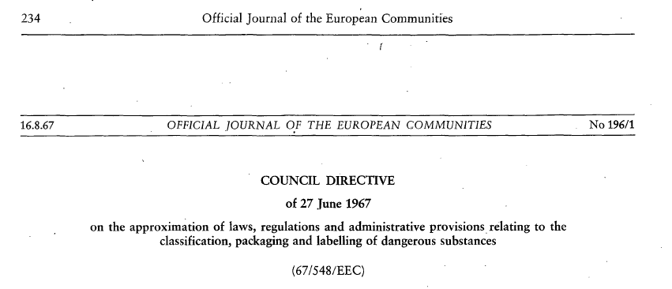
Dangerous substances
Old regulation

Slide 35
Mixtures
Preparations (Directive 1999/45/CE): homgeneous or inhomegeneous mixture formed by two or more substances;
Mixtures (Regulation EC No: 1272/2008, CLP): homgeneous or inhomegeneous mixture formed by two or more substances;

Slide 36
Dangerous Preparations
Old Regulations
1999/45/EC Directive(DPD, Dangerous Preparations Directive)
D.Lgs. 14 march 2003, n. 65 – Transposition of the 1999/45/EC and 2001/60/EC directive, concerning the classification, labelling and packaging of dangerous preparations
It regulates the classification, labelling and packaging of the preparations on market that contain at least one dangerous substance
It defines the way in which, starting from the contained substances, a preparation is classified as dangerous

Slide 37
Chemicals
D. Lgs. 81/2008:
  agenti chimici: all the chemical elements or compounds, either alone or in mixtures thereof, in their natural state or obtained, used or disposed of, including disposal as waste, by any work activity, whether or not produced intentionally and placed or not on the market;
  agenti chimici pericolosi:
    chemicals that are, or may be, classified as hazardous substances, excluded the substances hazardous only for the environment;
    chemicals that are, or may be, classifiesd as hazardous mixtures, excluded the substances hazardous only for the environment;
    chemical agents which, although not classified as dangerous, according to the numbers 1) and 2), may pose a risk to the safety and health of workers due to their physico-chemical properties, chemical or toxicological properties and the way in which they are used or present in the workplace, including any chemical agent that has been assigned an exposure limit value.

Slide 38
The management of industrial chemicals in the EU
At the United Nations Conference on Environment and Development (UNCED) in 1992 in Rio de Janeiro, agreement was reached on an action plan to reach substainable development in a number of environmental policy areas.
Substainable development was defined in the Bruntland report of 1987 as: “development which meets the needs of the present without compromising the abilities of the future generations to meet their own needs”.
The old EU legislative framework for industrial chemicals was an assembly of many different Directives and Regulations which developed historically. For
example, there were different rules for “existing” and “new” chemicals. This distinction between so-called “existing” and “new” chemicals was based on a cut-off date of 1981. All chemicals that were put on the market before 1981 were called “existing” chemicals. In 1981, these numbered 100,106 different substances. Chemicals introduced onto the market after 1981 (about 3000 until
2007) were termed “new” chemicals.

Slide 39
The management of industrial chemicals in the EU
The main problems were related to the lack of progress in the area of existing chemicals and, in particular, the High Production Volume Chemicals (HPVCs), i.e., chemicals produced or imported in the EU in quantities of 1000 tonnes or more per year. For most (99%) of these chemicals, we do not have enough information about their effects and uses, and how they need to be handled
to be safe. Another problem was the management of new chemicals.
The European Inventory of Existing Commercial Chemical Substances (EINECS) lists more than 100,000 chemicals.
The allocation of responsibilities (burden of proof) is not appropriate: public authorities are responsible for evaluating safety and demonstrating the risk
of substances rather than the businesses that manufacture, import or use the substances.
Decisions on further testing of priority substances can only be taken via a lengthy committee procedure and can only be requested from industry after the authorities have proven that a substance may present a risk. Again, the burden of determining whether further information is needed rests on Member State
authorities and not on the businesses.

Slide 40
Substances Inventory
EINECS (European INventory of Existing Commercial chemical Substances) is an inventory of substances that were deemed to be on the European Community market between 1 January 1971 and 18 September 1981.
ELINCS (European LIst of Notified Chemical Substances) lists those substances which were notified under Directive 67/548/EEC, the Dangerous Substances Directive Notification of New Substances (NONS) that became commercially available after 18 September 1981.

Slide 41
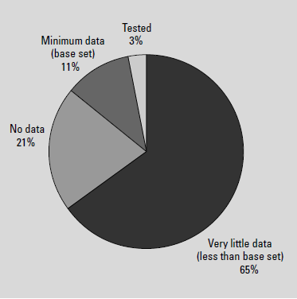
The management of industrial chemicals in the EU

Slide 42
The management of industrial chemicals in the EU
In 1998, the Environment Ministers met at an informal meeting in Chester, UK, to discuss the Community approach to the management of industrial chemicals.
They recognized the need for a review of the industrial chemicals legislation as it was not living up to the expectations originally set and was not meeting the
new challenges. These observations led to formal Council Conclusions in June 1999 and a Commission White Paper outlining a future chemicals policy in February 2001.
According to the White Paper the EU chemicals policy must ensure a high level of protection of human health and the environment as enshrined in the Treaty for the present generation and future generations, while also ensuring the efficient functioning of the internal market and the competitiveness of the chemical industry.
Fundamental to achieving these objectives is the precautionary principle. Whenever reliable scientific evidence is available that a substance may have
an adverse impact on human health and the environment but there is still scientific uncertainty about the precise nature or the magnitude of the potential damage, decision-making must be based on precaution in order to prevent damage to human health and the environment.

Slide 43
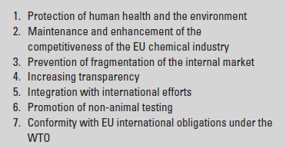
The management of industrial chemicals in the EU
The Commission presented a new strategy in the White Paper. The proposed system was called REACH: Registration, Evaluation and Authorization of Chemicals. The White Paper identified seven political objectives that need to be balanced within the overall framework of sustainable development, creating one single regulatory system for all substances.

Slide 44
REACH
REACH: Registration, Evaluation, Authorization and restriction of Chemicals;
European regulation, 1907/2006 EC, enacted the december 18th 2006, legally valid from june 1st 2007;
Born to overcome the limitations of the old legal system;
Modify and harmonize more than 40 EU regulations and directive;
Extend the field of application of procedures for chemicals.

Slide 45
European legislation
Regulation: they are immediately valid in every member state of the EU;
Directive: shared and implemented by individual states, that may change it but only more restrictively.The single states have a temporal range to transpose in their own legislation;
Decisions: binding for the states named therein (sales of UK beef ban);
Reccomendations and opinions: not binding;

Slide 46
Directives
There exist two different types:
  Product directives: they are enacted to ensure the free circulation of goods and the competition. They are addressed to the constructors, importer and sellers and list the minimum characteristics of the product that can be sold in EU (CE mark). According to art. 95 (former art. 100A) of the RomeTreaty;
  Social directives: they involve health and safety.
  According to art-137 (former art. 118A) of the Rome Treaty;

Slide 47
Transposing directives
The product directives are transposed by Ministero delle Attività Produttive e del Lavoro.
  Their violation is not configured as a penal crime: it involves the proibhition of the free circulation of the product in te EU market. The article 23 of the D. Lgs. 81/2008 avoid “production, sale, rental, and the right to use work equipment, personal protective equipment and systems that do not comply with laws and regulations on health and safety work”.
The social directives are transposed by Ministero della Salute o dell’Ambiente. Their violation is configured as a penal crime.

Slide 48
Registration
NO DATA, NO MARKET. Hazardous hemicals produced or circulating on the EU market (on their own or in mixtures or products) have to be registered
The registration of chemicals under REACH applies to each importer or manufacturer of a substance that is intentionally released in the EU in quantities ≥ 1 tonne/year.

Slide 49
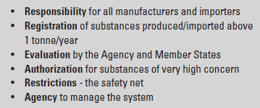
REACH

Slide 50
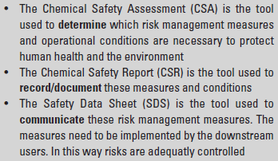
REACH

Slide 51
CLP
Regulation n. 1272/2008 EC.
CLP regulation deals with classification, labeling and packaging of chemicals, being them substances or mixtures
The CLP regulation modifies and repeal the directives 1967/548/EEC and 1999/45/EC and modifies the regulation n. 1907/2006 EU (REACH).

Slide 52
GHS
The CLP regulation unifies all the countries of the European Union to the Globally Harmonized System regarding the classification and labeling of chemicals.
The GHS ensures that the information on toxiticy and hazard associated with chemicals are the same all over the world.

Slide 53
WHY A GHS?
Example: chemical with an acute oral toxicity of LD₅₀ = 257 mg/kg
GHS | Lethal cat 3
EU | Harmful
USA | Toxic
Canada | Toxic
Australia | Harmful
India | Not toxic
Giappone | Toxic
Malesia | Harmful
Tailandia | Harmful
Nuova Zelanda | Dangerous
Cina | Not dangerous
Corea | Toxic

Slide 54
CLP objectives
As the preceding european directives, the main objective of trhe CLP regulation is to assess if a chemical substance or mixture has some properties that lead to classify it as hazardous.
When a substance or a mixture is classified has hazardous, the manufacturer, importers downstream users and dealers, have comunicate the identified hazards to the other subjects in the supply chain, including consumers.

Slide 55
CLP Purpose
The purpose of this Regulation is to ensure a high level of protection of human health and the environment as well as the free movement of substances, mixtures and articles as referred to in Article 4(8) by:
(a) harmonising the criteria for classification of substances and mixtures, and the rules on labelling and packaging for hazardous substances and mixtures;
(b) providing an obligation for:
(i) manufacturers, importers and downstream users to classify substances and mixtures placed on the market;
(ii) suppliers to label and package substances and mixtures placed on the market;
(iii) manufacturers, producers of articles and importers to classify those substances not placed on the market that are subject to registration or notification under Regulation (EC) No 1907/2006;
(c) providing an obligation for manufacturers and importers of substances to notify the Agency of such classifications and label elements if these have not been submitted to the Agency as part of a registration under Regulation (EC) No 1907/2006;
(d) establishing a list of substances with their harmonised classifications and labelling elements at Community level in Part 3 of Annex VI;
(e) establishing a classification and labelling inventory of substances, which is made up of all notifications, submissions and harmonised classifications and labelling elements referred to in points (c) and (d).

Slide 56
CLP does not apply to:
2. This Regulation shall not apply to the following:
(a) radioactive substances and mixtures within the scope of Council Directive 96/29/Euratom of 13 May 1996 laying down basic safety standards for the protection of the health of workers and the general public against the danger arising from ionising radiation (1);
(b) substances and mixtures which are subject to customs supervision, provided that they do not undergo any treatment or processing, and which are in temporary storage, or in a free zone or free warehouse with a view to re-exportation, or in transit;
(c) non-isolated intermediates;
(d) substances and mixtures for scientific research and development, which are not placed on the market, provided they are used under controlled conditions in accordance with Community workplace and environmental legislation.
3. Waste as defined in Directive 2006/12/EC of the European Parliament and of the Council of 5 April 2006 on waste (2) is not a substance, mixture or article within the meaning of Article 2 of this Regulation.
4. Member States may allow for exemptions from this Regulation in specific cases for certain substances or mixtures, where necessary in the interests of defence.

Slide 57
CLP does not apply to:
5. This Regulation shall not apply to substances and mixtures in the following forms, which are in the finished state, intended for the final user:
(a) medicinal products as defined in Directive 2001/83/EC;
(b) veterinary medicinal products as defined in Directive 2001/ 82/EC;
(c) cosmetic products as defined in Directive 76/768/EEC;
(d) medical devices as defined in Directives 90/385/EEC and 93/42/EEC, which are invasive or used in direct physical contact with the human body, and in Directive 98/79/EC;
(e) food or feeding stuffs as defined in Regulation (EC) No 178/ 2002 including when they are used:
(i) as a food additive in foodstuffs within the scope of Directive 89/107/EEC;
(ii) as a flavouring in foodstuffs within the scope of Directive 88/388/EEC and Decision 1999/217/EC;

Slide 58
CLP definitions
1. ‘hazard class’ means the nature of the physical, health or environmental hazard;
2. ‘hazard category’ means the division of criteria within each hazard class, specifying hazard severity;
3. ‘hazard pictogram’ means a graphical composition that includes a symbol plus other graphic elements, such as a border, background pattern or colour that is intended to convey specific information on the hazard concerned;
4. ‘signal word’ means a word that indicates the relative level of severity of hazards to alert the reader to a potential hazard; the following two levels are distinguished:
(a) ‘Danger’ means a signal word indicating the more severe hazard categories;
(b) ‘Warning’ means a signal word indicating the less severe hazard categories;

Slide 59
CLP definitions
5. ‘hazard statement’ means a phrase assigned to a hazard class and category that describes the nature of the hazards of a hazardous substance or mixture, including, where appropriate, the degree of hazard;
6. ‘precautionary statement’ means a phrase that describes recommended measure(s) to minimise or prevent adverse effects resulting from exposure to a hazardous substance or mixture due to its use or disposal;

Slide 60
Hazard Statements (H)
The code number of the hazard statements are composed by a three-digit number
H | x | yz
Where:
H means Hazard Statement;
x indicate the hazard class:
  2 → physical hazard;
  3 → health hazard
  4 → environmental hazrad
yz is a sequential number

Slide 61
Precautionary Statements
(P)
The code number of the hazard statements are composed by a three-digit number
P | x | yz
Where:
P means Precautionary Statement;
x means the kind of precautionary statement:
  1 → general
  2 → prevention;
  3 → response
  4 → storage
  5 → disposal
yz is a sequential number

Slide 62
Transition period
 |  | 2009 | 2010 | 2011 | 2012 | 2013 | 2014 | 2015 |  | 2016 | 2017 |  | 2018
Substance | Classification | DSD CLP optional |  | DSD and CLP |  |  |  |  | CLP
 | Labelling | (1/12/2010) DSD CLP optional but exclusive if applied |  | CLP possible DSD (1/12/2012) substances put on market before 1/12/2010 |  | CLP
 | Packaging | (1/12/2010) DSD CLP optional but exclusive if applied |  | CLP possible DSD (1/12/2012) substances put on market before 1/12/2010 |  | CLP
Mixture | Classification | DPD CLP optional |  |  |  |  |  |  | CLP
 | Labelling | DPD CLP optional but exclusive if applied |  |  |  |  |  |  | CLP possible DPD (1/06/2017) Substances puty on market before1/12/2015 |  |  | CLP
 | Packaging | DPD CLP optional but exclusive if applied |  |  |  |  |  |  | CLP possible DPP (1/06/2017) Substances put on merket before1/12/2015 |  |  | CLP

Slide 63
CLP and DSD/DPD differences and terminology
DSD/DPD | CLP GHS terminology
preparation | mixture
dangerous | hazardous
danger category | hazard classe and hazard category
nature of special risk | hazard statement
safety advice | precautionary statement

Slide 64
CLP and DSD/DPD differences
Labelling
DSD/DPD | CLP Terminologia del GHS dell’ONU
danger symbol | hazard pictogram
50 different nature of special risk phrases | 110 different hazard statements

Slide 65
Hazardous Substances Classification
The classification of a hazarodus substance or mixture depends on the physical and toxicological properties of the substance or mixture. It should reflect the entity of the hazard.
CLP regulation, as the older DSD and DPD, gives indications to dtermine the classification of a subsance or a mixture.

Slide 66
Dangerous Substances
DSD
  A substance is classified as dangerous if it belongs to one or more of the following categories:
Explosive
Oxidising
Flammable
Easily flammable
Extremely flammable
Toxic
Harmful
Corrosive
Irritant
Sensitizing
Carcinogenic
Mutagenic
Toxic for reproduction
Dangerous for the environment
Three danger categories: physical, health and environment danger)

Slide 67
Classification of Dangerous Substances
Dangerosu substances are classified according to their properties, using quantitative criteria;
In the DSD to every dangerosu substance corresponds:
  Kind of risk (toxic, harmful, explosive, etc.);
  Danger symbol;
  Nature od Special Risk;
  Safety Advices;

Slide 68
Classification of Dangerous Preparations
Their classification is made starting from the classification of the single substances forming the preparation
There are some formula that weight the risk deriving by any single substance considering its amount in the mixture

Slide 69
CLP Classification
In the CLP regulation substances and mixtures are classified according to the following hazard classes:
  Physical hazards;
  Health hazards;
  Environmental hazards;
  Additional EU hazards: hazard to the ozone layer
Each class is divided in categories

Slide 70
CLP
Physical hazards
Explosive;
Flammable gases;
Flammabel aerosols;
Oxidizing gases;
Gases under pressure;
Flammable liquids;
Flammable solids;
Self-reactive substances and mixtures;
Pyrophoric liquids;
Pyrophoric solids;
Self-heating substances and mixtures;
Substances and mixtures which in contact with water emit flammable gases;
Oxidizing liquids;
Oxidizing solids;
Organic peroxides;
Substances and mixtures which in contact with water emit flammable gases;
Corrosive to metals;

Slide 71
CLP
Health Hazard
Acute toxicity
Skin corrosion/irritation
Serious eye damage/eye irritation
Respiratory or skin sensitization
Germ cell mutagenity
Carcinogenity
Reproductive toxicity
Specific target organ toxicity – single exposure
Specific target organ toxicity – repeated exposure
Aspiration hazard

Slide 72
Labels
The hazardous chemicals containers must have labels containing symbols and information about their characteristics (name, chemical formula, etc..), their hazard, the wya in which they have to be manipulated
According to CLP regulation labels are different with respect to that erequired by the older DSD and DPD

Slide 73
DSD labelling
Labels must contain:
  Name of the substance
  The origin of the substance
  The danger symbol and indication of danger involved in the use of the substance
  A reference to the special risks arising from such dangers

Slide 74
Labelling of mixture
DPD
The label must contain
- The trade name or designation of the preparation
- The name, full address and telephone number of the person established in the Community who is responsible for placing the preeparation on the market, whether it be the manufacturer, the importer or the distributor
- The chemical name of the substance or substances present in the preparation
- The danger symbol(s) and the indication of danger(s)
- The risk phrases (R phrases): as a general rule a maximum of six R phrases shall suffice to describe the risks
- The safety advice (S phrases)

Slide 75
Labelling of substances and mixtures according to CLP
TITLE III HAZARD COMMUNICATION IN THE FORM OF LABELLING
CHAPTER 1
Content of the label
Article 17
General rules
1. A substance or mixture classified as hazardous and contained in packaging shall bear a label including the following elements:
(a) the name, address and telephone number of the supplier(s);
(b) the nominal quantity of the substance or mixture in the package made available to the general public, unless this quantity is specified elsewhere on the package;
(c) product identifiers as specified in Article 18;
(d) where applicable, hazard pictograms in accordance with Article 19;
(e) where applicable, signal words in accordance with Article 20;

Slide 76
Labelling of substances and mixtures according to CLP
(f) where applicable, hazard statements in accordance with Article 21;
(g) where applicable, the appropriate precautionary statements in accordance with Article 22;
(h) where applicable, a section for supplemental information in accordance with Article 25.
2. The label shall be written in the official language(s) of the Member State(s) where the substance or mixture is placed on the market, unless the Member State(s) concerned provide(s) otherwise. Suppliers may use more languages on their labels than those required by the Member States, provided that the same details appear in all languages used.

Slide 77
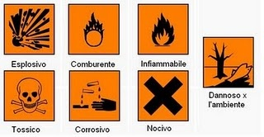
Danger Symbols DSD/DPD

Slide 78









Pictograms
CLP
Tossico acuto
esplosivo
infiammabile
corrosivo
gravi effetti
per la salute
pericoloso per l’ambiente
Gas sotto
pressione
ossidante
effetti più lievi
per la salute

Slide 79
Physical hazard pictograms
Classe di pericolo | Pittogramma | Classe di pericolo | Pittogramma
Esplosivi |  | Solidi infiammabili
Gas infiammabili |  | Liquidi piroforici
Aerosol infiammabili |  | Solidi piroforici
Gas comburenti |  | Sostanze autoriscaldanti
Gas sotto pressione |  | Sostanze che a contatto con l’acqua emettono gas infiammabili
Liquidi infiammabili |  | Corrosivi per i metalli

Slide 80
Health hazard pictograms
Classe di pericolo | Pittogramma | Classe di pericolo | Pittogramma
Tossicità acuta |  | Cancerogenicità
Corrosione/irritazione cutanea |  | Tossicità riproduttiva
Gravi danni agli occhi/irritazione |  | Tossicità sistemica su organi bersaglio (STOT) singola
Sensibilizzazione cutanea e respiratoria |  | Tossicità sistemica su organi bersaglio (STOT) ripetuta
Mutagenicità |  | Pericolo di aspirazione

Slide 81
Risk phrases (DSD) and hazard statements (CLP)
R 17: Spontaneously flasmmable in air | H250 – Catches fire spontaneously if exposed to air
R 21: Harmful in contac with skin | H312 – Harmful in contac with skin
R 37: May cause respiratory irritation | H335 – May cause respiratory irritation
R 39 Danger of very serious irreversible effects + R 23 Toxic by inhalation | H370 – Causes damage to organs
R 39 Danger of very serious irreversible effects + R 24 Toxic in contact with skin | H370 – Causes damage to organs
R 45: May cause cancer | H350 – May cause cancer
R 49: May cause cancer by inhalation | H350i – May cause cancer if inhalated
R 50: Very toxic to acquatic organisms | H400 – Very toxic to acquatic life

Slide 82
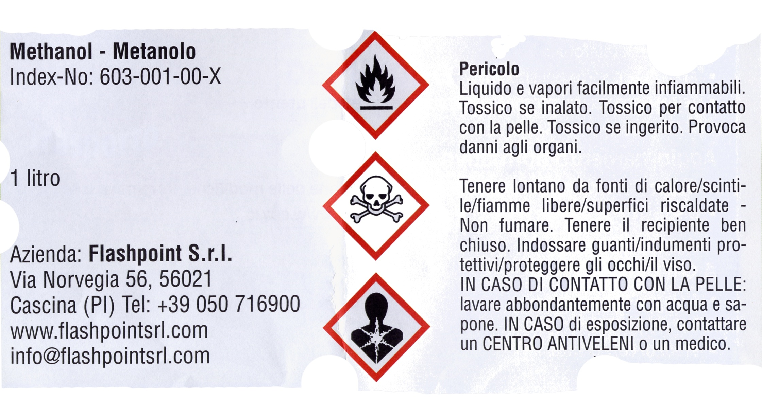
Label according to CLP

Slide 83
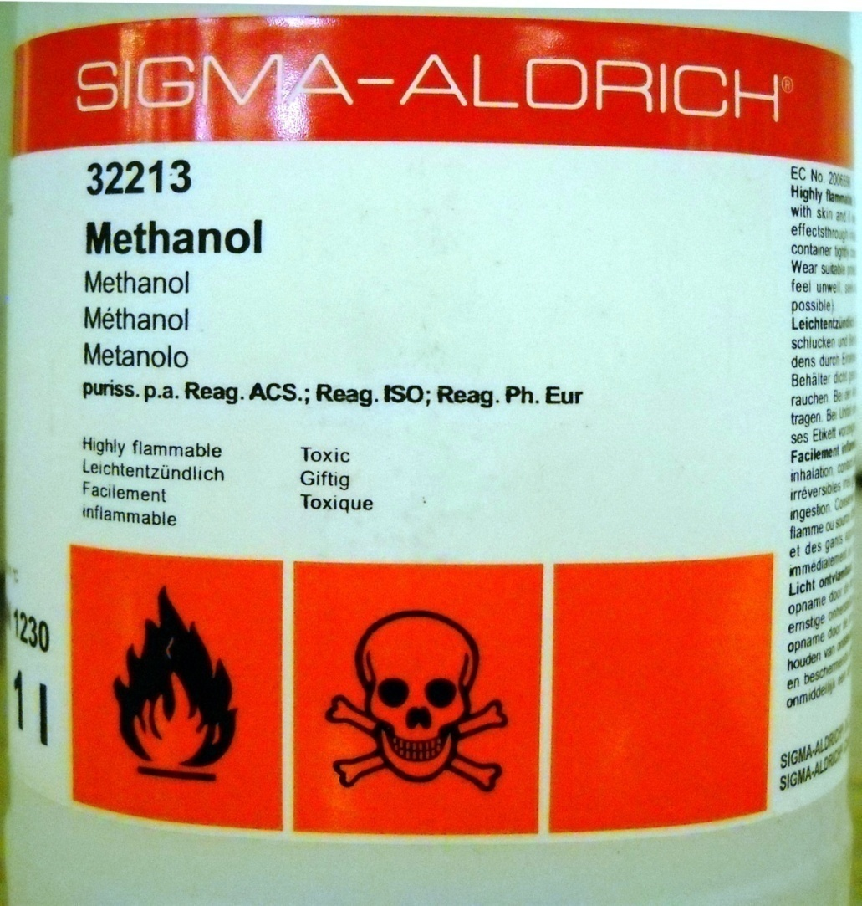
Label according to
DSD
R11: Highly flammable
R23/24/25: Toxic by inhalation,Toxic in contact with skin, Toxic if swallowed e per ingestione
R39/23/24/25: Danger of very serious irreversible effects if inhalated, contact with skin, if swallowed
S01, S02: Keep locked up, keep out of the reach of children
S07: Keep container tightly closed
S16: Keep away from sources of ignition – No smoking
S36, S37: Wear suitable protecting clothing, wear suitable gloves
S45: In case of accident or if you feel unwell, seek medical advice immediately (show the label where possible)

Slide 84
CLP
HEALTH HAZARD

Slide 85
Safety in teaching and research laboratories
TOXIC EFFECTS OF CHEMICAL AGENTS

Slide 86
Toxicity
Toxicity is the degree to which a chemical agent can damage an organism. Toxicity can refer to the systemic effect on a whole organism, as well as the effect on a substructure of the organism, or an organ.
Systemic means that the adverse effect of some substance involve the body as a whole, rather than one part.

Slide 87
Acute and chronic toxicity
Acute toxicity means those adverse effects occurring following oral ror dermal administration of a single dose of a substance, or a mixture, or multiple doses given within 24 hours, or an inhalatin exposure of 4 hours
Chronic toxicity is the development of adverse effects as the result of long term exposure to a toxicant or other stressor. It can manifest as direct lethality but more commonly refers to sublethal endpoits.
A chemical agent with chronic toxicity can be a susbatnce, or mixture, that accumulates in some biological tissues up to a certain point in which there is the manifetsation of the adverse effects

Slide 88
Acute and chronic toxicant
Toxicant class | Acute toxicant | Chronic toxicant
Irritants | Al₂O₃, CS₂, EDTA
Sensitizers | Formaldheyde, diazomehtane, aluminum tricloride
Asphyxiating substances | CO, N₂, He, CO₂, CH₄, H₂
Teratogens | Ethanol, acrylonitrile, nitrogen mustards
Carcinogenics |  | Ethylene oxide, Cr(VI) compounds, benzene, chloroform, vinyl chloride
Toxicants to organs | Ethanol, aniline, toluene, DMF, CCl₄ | Hg, hexane, phenol
Neurotoxins | Dimethyl mercury, acetone, CS₂, ethanol | Acrylamide, Pb, CH₃I
Poisons | cianide, OsO₄, P, sodium azide | Arsenic compound, P, OsO₄

Slide 89
Exposure
The concept of exposure demonstrates that the same substance may or may not be dangerous depending on the conditions.
We have to consider three different aspect of the exposure:
  Dose (how many);
  Duration (how long) and frequency (how many times);
  Way of exposure: oral, dermal, inhalation.
Changing one of the different exposure parameters could be decisive determining the risk of a chemical.

Slide 90
Dose and response
The response of an organism to a toxicant always depends to some extent on the amount of the agent used.
Dose: is defined as the degree of exposure of an organism to a toxicant and is usually expressed in terms of mass of the toxicant per unit body mass of the organism.
Response: is the adverse observed effect on the body following the intake of the toxicant.
The response to an extremely low level of an agent is called hypersentitivity
Dose and response may vary according to the way of intake

Slide 91
Dose
As general considerations:
Higher the dose shorter is the time required for the adverse effect to manifest;
Higher the dose, more severe are the adverse effects
Low doses may not provoke immediately visible adverse effects, but may provoke long term effects

Slide 92
Treshold
The treshold is the lower dose for which the adverse effect start to manifest.
For most of chemicals there exist a treshold
If the chemical is highly toxic the treshold could be very low.The treshold level value have to be reported in the safety data sheet

Slide 93
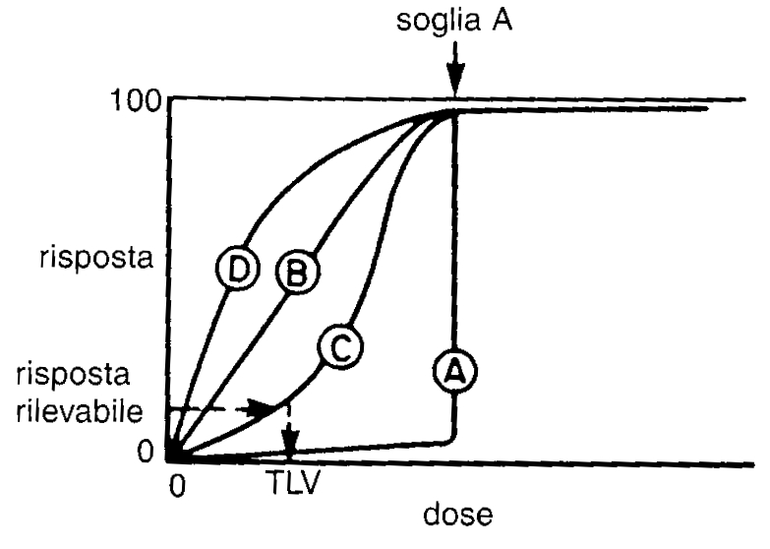
Dose-response curves
Curve A: it shows a typical treshold value
Curve B: linear response
Curve C: sigmoidal curve
Curve D: more than linear response

Slide 94
Lethal dose
The toxicity level of chemicals is ususlly expressed with the lethal dose, LD
Chemicals are tested on model animals in experiments that determine the dose needed to kill the 50% of them. This value is idicated as LD₅₀
If the chemical is orally intaken the lethal dose is indicated as OLD₅₀
Lethal doses are usually expressed as mg of toxicant per kg of body mass
If the toxicant is inhalated it is indicated as lethal concentration, LC₅₀

Slide 95
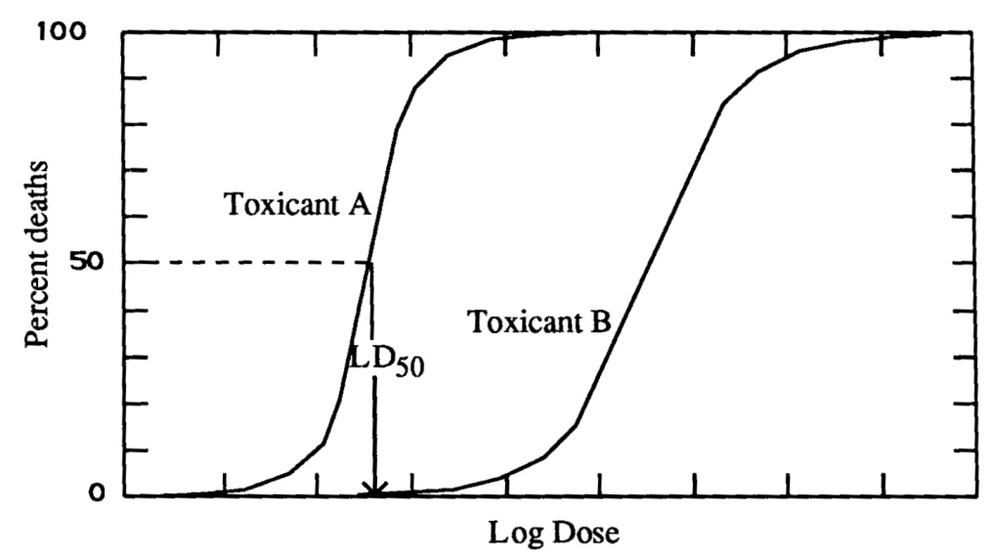
LD₅₀ curve
The lethal dose - response curve usually is of sigmoidal form, and the LD₅₀ is the inflection point;
Toxicant A has a higher toxicity than toxicant B

Slide 96
Approximated quantities of a chemical orally ingested by human, corresponding to LD₅₀ in animal
Quantity
LD₅₀ (mg/kg)‏
Orally intaken by 70 kg human
Toxicity
Up to 50
1 tea spoon or less
Extremely toxic
Between 50 and 500
From a tea spoon to 30 ml
Highly toxic
Between 500 and 5000
From 30 ml to ½ l
Moderately toxic
Between 5000 and 15000
Form ½ l to 1 l
Poorly toxic
Over 15000
More than a liter
Pratically non toxic
Adapted from: R.E. Gosselin et al. – Clinical Toxicology of Commercial Products – Williams & Wilkins (1984)‏

Slide 97
Threshold limit values
Occupational exposure to certain substances or mixtures is regulated by threshold limit values. There are three different threshold limti values:
  TWA - Time Weighted Average
  STEL- Short Term Exposure Limit
  C – Ceiling
The D.Lgs. 81/2008 defines the professional exposure limit as “the time-weighted average concentration limit of a chemical in the air within a worker's breathing zone in relation to a given reference period”.

Slide 98
Dose
Exposure frequency
The exposure frequency to a dangerous chemical can have effects on the kind, the time, the severity of the health damage.
Some chemicals can cause a sudden damage at the first exposure (acute toxicity), others may cause damage only after a prolonged and repeated exposure (chronic toxicity).

Slide 99
Exposure route
Ingestion and inhalation
Ingestion. Very often is accidenta, but nnt always (eat and drink in lab, to bring contaminated hands to mouth, etc.);
Inhalation. Is the most concerning exposure route, and it is the one that produce more fastly the adverse effects. It is immportant for gases, dusts, vapours, aerosols. Many gases have no odour (CO, inhert gases), others have an olfactory detection threshold lower than that of toxicity (methanol, phosgene, chloropicrin).

Slide 100
Exposure route
Skin
Dhermal absorption. Usually is a slow process, at least for healthy skin.
It can become faster if the skin is lesionated.
There are chemicals that are able to very easily penetrate from the skin and can cause death in 30 minutes.
A typical intoxication way is using contaminated clothing.

Slide 101
Exposure route
Eye
If a toxicant comes into contact with the eye, it can reapidly enters intoo the blood circulation system or it could be swallowed due to the connection with nose and mouth
Liquids and dusts can become in contact with the eye due to splashes or contact with contaminated hands
Gases, vapours and aerosols can directly come in contact with the eye

Slide 102
Variability of toxicity with the exposure route
Substance | OLD₅₀ (mg/kg) | Skin LD₅₀ (mg/kg) | Inhalation LC₅₀
Acrylonitrile | 78 (rat) | 148 (rat) | 333 ppm/4h (rat)
Methanol | 14200 (rabbit) | 15800 (rabbit) | 81000 ppm(14 h (rabbit)
Aniline | 250 (rat) | 1400 (rat) | 250 ppm/1h (rat)
Triiodomethane | 355 (rat) | 1184 (rat) | 183 ppm/7 h (rat)

Slide 103
Species variability of OLD₅₀
Substance | Specie | OLD₅₀ (μg/kg)
TCDD | Hamster | 1157
TCDD | Mouse | 114
TCDD | Monkey | 2
TCDD | Guinea pig | 0,5
TCDD = 2,3,7,8-tetrachlorodibenzo-p-dioxine

Slide 104
Age dependency of toxicity
Usually very young or very old people are more exposed to the toxic effects of chemicals.
The biological systems of childern are not fully developed and this can produce a greater vulnerability.
Aging usually produces flaws in the body’s protective systems and often is associated with chronic illnesses that weaken the body.

Slide 105
Male to female differences in toxicity
Sometimes there are different toxicity levels for male or female exposed person.
This is particularly true when the toxic effect involve the reproductive system
There are not many studies in this field, except for contraceptives
However, it is well known that dibromochloropropane causes infertility in males.

Slide 106
First aid in case of toxicant exposure
Remove the chemical from the exposure site washing for at least 15 minutes (safety shower);
Remove the contaminated chlotescontaminati ;
Do not use solvents different from water to remove the chemicals
The eyes should also be washed thoroughly for at least 15 minutes, during which the eyelids will be raised, moving the bulb in all directions

Slide 107
First aid in case of toxicant exposure
During washing operations some of the people in the room should worry about calling 118 phone number;
Only on medical indication you will have to stop washing before 15 minutes

Slide 108
First aid
Ingestion
In case of ingestion the first aid treatment varies from substance to substance
Do not induce vomiting unless the safety data sheet of the ingested product explicitly tells you;
If the person has lost knowledge, do not try to cause vomiting even if the safety data sheet advises you.
Also in this case contact the 118 phone number

Slide 109
First aid
Inhalation
Even in the case of inhalation the first thing to do is try to dilute the dangerous chemical;
The person must be removed from the contaminated air and allowed to breath fresh air
Also in this case contact the 118 phone number

Slide 110
Acute toxicity (CLP)
Definitions
Acute toxicity means those adverse effects occurring following oral ror dermal administration of a single dose of a substance, or a mixture, or multiple doses given within 24 hours, or an inhalatin exposure of 4 hours
The hazard class «Acute toxicity» is differentiated into:
  — Acute oral toxicity;
  — Acute dermal toxicity;
  — Acute inhalation toxicity;

Slide 111
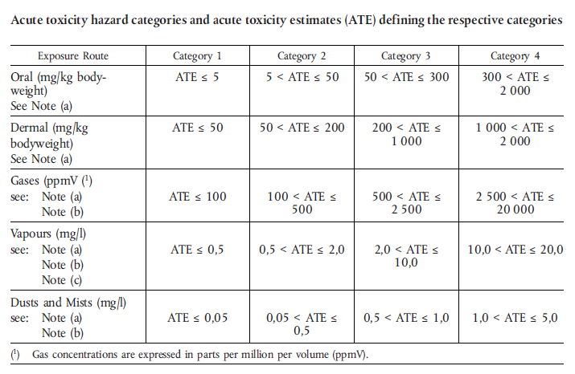
Acute toxicity (CLP)

Slide 112
Acute toxicity (CLP) dust, mist and vapour
The terms «dust», «mist» and «vapour» are defined as follows:
  — dust: solid particles of a substance or mixture suspended in a gas (usually air);
  — mist: liquid droplet of a substance or mixture suspended in a gas (usually air);
  — vapour: the gaseous form of a substance or mixture released from its liquid or solid state.
Dust is generally formed by mechanical processes. Mist is generally formed by condensation of supersaturated vapours or by physical shearing of liquids. Dusts and mists generally have sizes ranging from less than 1 to about 100 μm.

Slide 113
Acute toxicity label elements - oral
Classification | Category 1 | Category 2 | Category 3 | Category 4
GHS pictograms
Signal word | Danger | Danger | Danger | Warning
Hazard statement | H300: Fatal if swallowed | H300: Fatal if swallowed | H301: Toxic if swallowed | H302: Harmful if swallowed
Precautionary statement Prevention | P264 P270 | P264 P270 | P264 P270 | P264 P270
Precautionary statement Response | P301 + P310 P321 P330 | P301 + P310 P321 P330 | P301 + P310 P321 P330 | P301 + P312 P330
Precautionary statement Storage | P405 | P405 | P405
Precautionary statement Disposal | P501 | P501 | P501 | P501

Slide 114
First and second category toxicant (fatal)
Substance | OLD₅₀ (rat) | Origin | Category
Botulinum toxin | 0.000001 | Natural | 1
B aflatoxin | 0.048 | Natural | 1
Tetradotoxin | 0.3 (mouse) | Natural | 1
As₂O₃ | 1.5 | Synthetic | 1
Phosphorus | 3 | Synthetic | 1
Sodium cyanide | 6.5 | Synthetic | 2
Hydrogen cyanide | 10 | Synthetic | 2
Trimethyl tin chloride | 13 | Synthetic | 2
OsO₄ | 14 | Synthetic | 2
Acrolein | 42 | Synthetic | 2
Sodium azide | 27 | Synthetic | 2
Nicotine | 50 | Natural | 2

Slide 115
Acute toxicity labvel elements - dermal
Classification | Category 1 | Category 2 | Category 3 | Category 4
GHS Pictograms
Signal word | Danger | Danger | Danger | Warning
Hazard statement | H310: Fatal in contact with skin | H310: Fatal in contact with skin | H311: Toxic in contact with skin | H312: Harmful in contact with skin
Precautionary statement Prevention | P262 P264 P270 P280 | P262 P264 P270 P280 | P280 | P280
Precautionary statement Response | P302 + P350 P310 P322 P361 P363 | P302 + P350 P310 P322 P361 P363 | P302 + P352 P312 P322 P361 P363 | P302 + P352 P312 P322 P363
Precautioonary statement Storage | P405 | P405 | P405
Precautionary staement Disposal | P501 | P501 | P501 | P501

Slide 116
Acute toxicity label elements - inhalation
Classification | Category 1 | Category 2 | Category 3 | Category 4
GHS Pictograms
Signal word | Danger | Danger | Danger | Warning
Hazard statement | H330: Fatal if inhaled | H330: Fatal if inhaled | H331: Toxic if inhaled | H332: Harmful if inhaled
Precautionary statement Prevention | P260 P271 P284 | P260 P271 P284 | P261 P271 | P261 P271
Precautionary statement Response | P304 + P340 P310 P320 | P304 + P340 P310 P320 | P304 + P340 P311 P321 | P304 + P340 P312
Precautionary statement Strorage | P403 + P233 P405 | P403 + P233 P405 | P403 + P233 P405
Precautionary statement Disposal | P501 | P501 | P501

Slide 117
Corrosive substances
The most dangerous local reactions are corrosion.
Corrosion causes tissue destruction. Some substances may pierce the skin up to the bone.
There are solid, liquid and corrosive gases. The corrosivity of a gas and a liquid is often immediate, while that of a solid can be slower allowing it to be removed
However, some solids react very exothermically with the water of the tissues and this heat can be responsible of the tissue dectruction.

Slide 118
Irritating substances
Irritants are non-corrosive chemicals that cause reversible inflammation (redness, swelling, eruptions, blisters) and often itching
Contact dermatitis is one of the most common occupational diseases
The irritanting feature is the most widespread among those that classify a chemical agent as dangerous to health

Slide 119
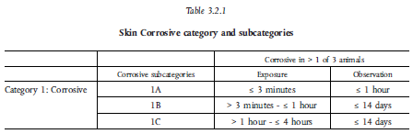
Corrosive
A substance is classified as as corrosive based on the results of animal tests

Slide 120
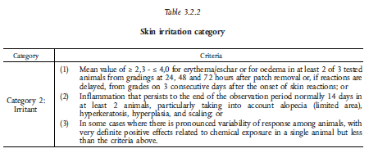
Irritant
A substance is classified as as irritant based on the results of animal tests

Slide 121
Corrosive/Irritating label elements
Classification | Category 1A/1B/1C | Category 2
GHS Pictograms
Signal word | Danger | Warning
Hazard statement | H314: Causes severe skin burns and eye damage | H315: Causes skin irritation
Precautionary statement Prevention | P260 P264 P280 | P264 P280
Precautionary statement Response | P301 + P330 + P331 P303 + P361 + P353 P363 P304 + P340 P310 P321 P305 + P351 + P338 | P302 + P352 P321 P332 + P313 P362
Precautionary statement Storage | P405
Precautionary statement Disposal | P501

Slide 122
Serious eye injuries eye irritation
Serious eye injuries: eye tissue injuries or severe deterioration of vision resulting from the application of a test substance on the anterior surface of the eye, not completely reversible within 21 day of application
Eye irritation: eye alteration resulting from the application of test substances on the anterior surface of the eye, totally reversible within 21 days from application

Slide 123
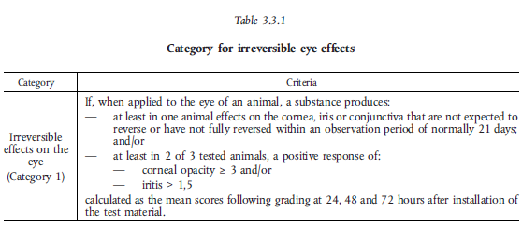
Serious eye injuries eye irritation
Category classification 1

Slide 124
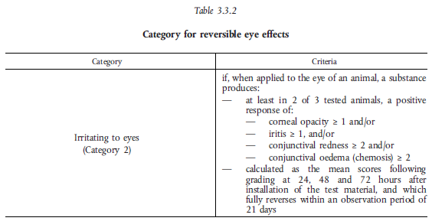
Serious eye injuries
eye irritation
category classification 1

Slide 125
Serious eye injuries, eye irritation
label elements
Classification | Category 1 | Category 2
GHS Pictograms
Signal word | Danger | Warning
Indicazione di pericolo | H318: Causes serious eye damage | H319: Causes serious eye irritation
Precautionary statement Prevention | P280 | P264 P280
Precautionary statement Response | P305 + P351 + P338 P310 | P305 + P351 + P338 P337 + P313
Precautionary statement Storage
Precautionary statement Disposal

Slide 126
Common corrosive liquids
Inorganica acids | Organic acids
Chromic | Acetic
Nitric | Butyric
Sulphuric | Formic
Inorganic compounds | Organic solvents
Bromine | Dichloroethylene
Phosphorosus trichloride | Perchloroethylene
Sulphuryl chloride | Methyl-ethyl-ketone
Peroxides | Gasoline
Caustic solutions | Other organic compounds
Ammonia | Acetic anhydride
Sodium hydroxide | Triethanolamine
Potassium hydroxide

Slide 127
Common corrosive solids
Alkali | Organic acids
Calcium oxide | Oxalic
Calcium hydroxide | Salycilic
Potassium hydroxide | Trichloroacetic
Sodium hydroxide
Sodium phosphate
Altri composti | Elements
Cloruro di stagno | Sodium
Pentossido di fosforo | Potassium
Cromato di potassio | Lithium
Cloruro di mercurio | Phosphorus
 | Iodine

Slide 128
Irritating substances
Berillium and its compounds
Carbon disulfide
Epthane
Cyclohexane
N-hexane
Tetramethyl-thiuram-disulfide
Silicon tetrachloride
Dimethyl-dichloro-sylane
Tributyl-phosphate

Slide 129
Eye damage/irritation
Category 1
α-chlorotoluene
α,α,α-trichlorotoluene
α,α-dichlorotoluene
2,3-dichloropropene
2-chloro-4,5-difluorobenzoic acid
n-propanol
n-butanol
diethanolamine
Category 2
Acetone
Butanone
Sodium carbonate
Tetrahydrofuran
Ethylacetate
Isopropanol

Slide 130
Sensitiser
Sensitisers are chemicals that produce their adverse effects inducing a hypersensitivity or an allergic response.
They are classified as acute toxicant but the sensitisation includes two phases: the first phase is induction of specialized immunological memory. The seconnd phase is elicitation, i.e. production of a cell-mediated or antibody-mediated allergic response by exposure of a sensitized individual to an allergene.

Slide 131
Sensitisation effects
When a person is sensitised to a chemical, a subsequent exposure to a small amount can also produce an allergic reaction such as allergic contact dermatitis, urticaria, nasal secretion, sneezing, headache
A respiratory sensitiser can produce asthma, difficulty in breathing and, rarely, anaphylactic shock.
A genetic component of sensitization has been proven. Not all people exposed to a given allergen are aware of it

Slide 132
Respiratory and skin sensitisers
Label elements
Classification | Respiratory sensitiser | Skin senistisers
 | Category 1 | Category 1
GHS Pictograms
Signal word | Danhger | Warning
Hazrad statement | H334: May cause allergy or asthma symptoms or brething difficulties if inhaled | H317: May cause an allergic skin reaction
Precautionary statement Prevention | P261 P285 | P261 P272 P280
Precautionary statement Response | P304 + P341 P342+ P311 | P302 + P352 P333 + P313 P321 P363
Precautionary statement Storage
Precautionary statement Disposal | P501 | P501

Slide 133
Sensitisers
Formaldheyde (skin)
Toluene diisocyanate (respiratory and skin)
1-fluoro-2,4-dinitrobenzene (skin)
Potassium dichromate (respiratory and skin)
N,N’-dicyclohexildicarbodiimide (skin)
Latex (respiratory and skin)

Slide 134
Chronic toxicity
Chronic toxicity is the production of systemic damage due to repeated exposure to small doses of a chemical for a long time
The result is a chronic intoxication, cancer or other effects
Acute toxicity does not necessarily precede chronic. Symptoms of chronic toxicity often appear slowly and progressively and it is not always easy to recognize the correlation with the exposure to the agent

Slide 135
Chronic toxicity
Although case observation induces suspicion that a certain agent produces chronic toxicity, establishing the link between exposure and effect is often very difficult;
Often large number of subjects epidemiological studies are needed to infer correlation by statistical analysis.
First of all there are animal studies that are followed by epidemiological studies on population samples.

Slide 136
Germ cell mutagenicity
A mutation means a permanent change in the amount or structure of genetic material in a cell
The term mutagenic and mutagen will be used for agents giving rise to an increased occurrence of mutation in popualtions of cell and/or organisms.
This hazard class is primarily concerned with substances that may cause mutations in the germ cells of human that can be transmitted to the progeny

Slide 137
Germ cell mutagenicity
The more gebneral terms «genotoxic» and «genotoxicity» apply to agents or processes which alter te structure, the information content, or segregation of DNA, including thiose which cause DNA damage by interfering with normal replication processes, or which in a non-physiological manner (temporarily) alter its replication. Genotoxicity test results are usually taken as indicators for mutagenic effects.

Slide 138
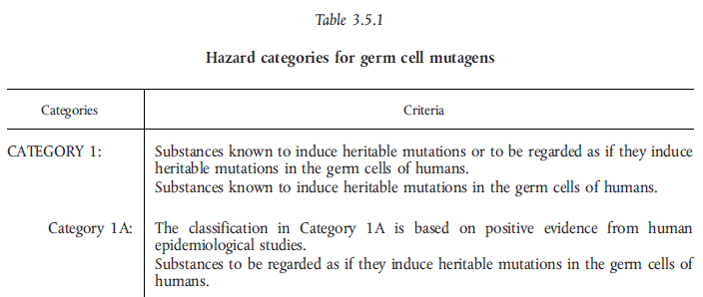
Cerm gell mutagenicity classification

Slide 139
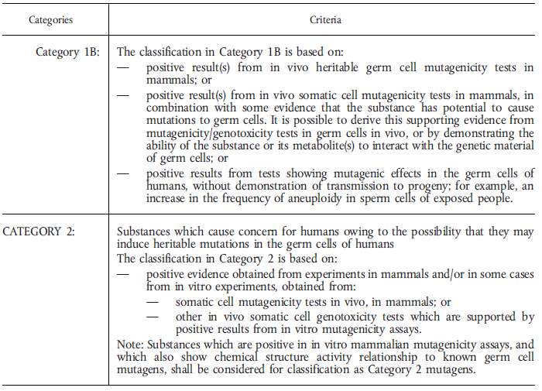
Germ gell mutagenicity
classification

Slide 140
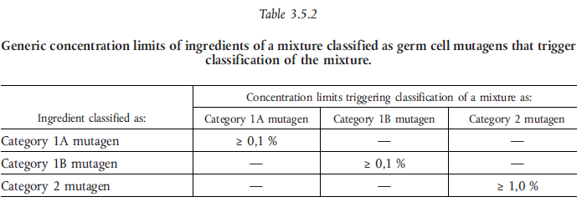
Germ cell mutagenicity mixtures classification

Slide 141
Germ cell mutagenicity
Label elements
Classification | Category 1A or category 1B | Category 2
GHS Pictograms
Signal word | Danger | Warning
Hazard statement | H340: May cause genetic defects (state route of exposure if it is conclusively proven that no other route of exposure cause the hazard) | H341: Ssuspected to cause genetic defects (state route of exposure if it is conclusively proven that no other route of exposure cause the hazard)
Precautionary statement Prevention | P201 P202 P281 | P201 P202 P281
Precautionary statement Response | P308 + P313 | P308 + P313
Precautionary statement Storage | P405 | P405
Precautionary statement Disposal | P501 | P501

Slide 142
Carcinogenity
Definition
Carcinogen means a substance or a mixture of substances which induce cancer or increase its incidence.
Substances which have induced benign or malignant tumors in well performed experimental studies on animals are considered also to be presumed or suspected human carcinogens unless there is strong evidence that the mechanism of tumor formation is not relevant for humans.

Slide 143
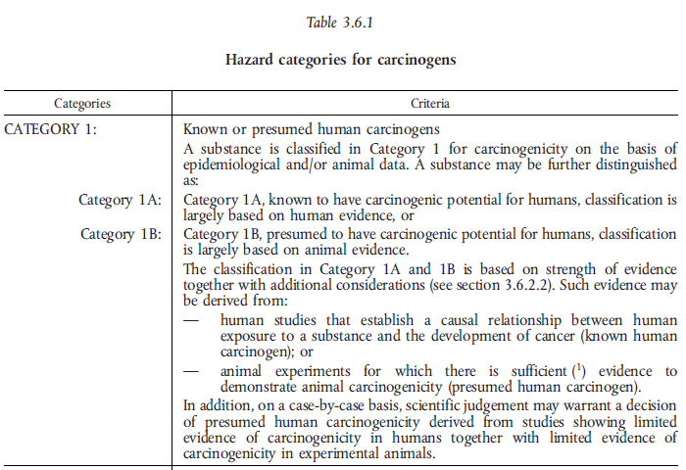
Carcinogenity
Classification

Slide 144
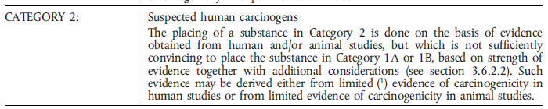
Carcinogenity
Classification

Slide 145
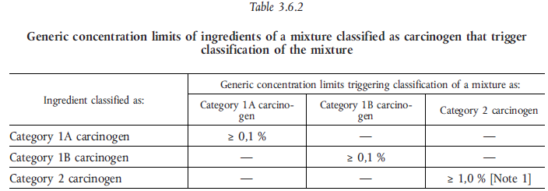
Carcinogenicity
Classification of mixtures

Slide 146
Carcinogenicity
Label elements
Classification | Category 1A or category 1B | Category 2
GHS Pictograms
Signal word | Danger | Warning
Hazard statement | H350: May cause cancer (state route of exposure if it is conclusively proven that no other route of exposure cause the hazard) | H351: Suspected of causing cancer (state route of exposure if it is conclusively proven that no other route of exposure cause the hazard)
Precautionary statement Prevention | P201 P202 P281 | P201 P202 P281
Precautionary statement Response | P308 + P313 | P308 + P313
Precautionary statement Storage | P405 | P405
Precautionary statement Disposal | P501 | P501

Slide 147
Carcinogenic substances
Asbestos
4-Nitrobiphenyl
1-Naphtylamine
Methyl-chloromethyl-ehter
3,3’-Dichlorobenzidine
Bis(chloromethyl)heter
2-Naphtylamine
Benzidine
4-Aminobiphenyl
Ethylenimine
β-Propiolactone
2-Acetylaminofluorene
4-Dimethylaminoazobenzene
N-nitrosodimethylamine
Vinyl chloride
Inorganic arsenic compounds
Chromium VI compounds
Cadmium and its compounds
Benzene
PAH
1,2-Dibromo-3-chloropropane
Acrylonitrile
Ethyleneoxide
Formaldehyde
Methylenedianiline
1,3-Butadiene
Methylenchloride

Slide 148
Carcinogenic and cancer type
Chemical | Cancer type
Arsenic | Skin and lung
Asbestos | Mesothelioma
Benzene | Leukemia
Benzidine | Urinary bladder
2-naphtylamine | Urinary bladder
Chromates | Respiratory tract
Nickel | Respiratory tract
Vinyl chloride | Angiosarcoma

Slide 149
Reproductive toxicity
Definitions and general considerations
Reproductive toxicity: includes adverse effects on sexual functio and fertility in adult males and females, as well as developmental toxicity in the offsprings.
For classification purposese, the known induction of genetically based heritable effects in the offsprings is addressed in Germ Cell Mutagenicity, since in the present classification system it is considered more appropriate to adress such effects under the separate hazard class of germ cell mutagenicity.

Slide 150
Reproductive toxicity
In this classification system, reproductive toxicity is subdivided into two major headings:
  a) adverse effects on sexual function and fertility;
  b) adverse effects on development of the offsprings.
Some reproductive toxic effects cannot be clearly assigned to either impairment of sexual function and fertility or to developmental toxicity.
Nonetheless, substances with these effects, or mixture containing them, shall be classified as reproductive toxicants.

Slide 151
Reproductive toxicity
For the purpose of classification the hazard class Reproductive Toxicity is differentiated into:
  adverse effects
    on sexual function and fertility, or
    on development;
  - effects on or via lactation

Slide 152
Reproductive toxicity
Advrese effects on sexual function and ferility
Any effetc of substances that has the potential to interfere with sexual function and fertility. This include, but is not limited to,
alteration to the female and male reproductive system,
adverse effects on the onset of puberty,
gamete production and transport,
reproductive cycle normality,
sexual behaviour,
fertility,
parturition,
pregnancy outcomes,
premature reproductive senescence,
or modifications in othe functions that are dependent on the integrity of the reproductive systems.

Slide 153
Reproductive toxicity
Adverse effects on development of offsprings
Developmental toxicity includes, in its widest sense, any effect which interferes with normal development of the conceptus, either before or after birth, and resulting from exposure of either parent prior to conception, or exposure of the developing offsprings during prenatal development, or postnatally, to the time of sexual maturation.
However, it is considered that classification under the heading of developmental toxicity isd primarily intended to provide a hazard warning for pregnant women, and for men and women of reproductive capacity.
Therefore, for pragmatci purposes of classification, developmental toxicity essentially means adverse effects induced during pregnancy, or as a result of parental exposure. These effects can be manifested at any point in the life span of the organism.
The major manifestations of developmental toxicity include:
  1) death of developing organism;
  2) structural abnormality;
  3) altered growth;
  4) functiona deficiency.

Slide 154
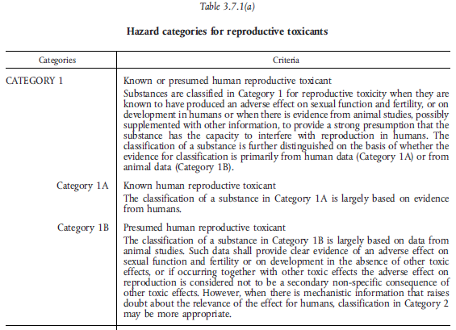
Reproductive toxicity
Classification

Slide 155
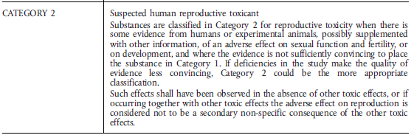
Reproductive toxicity
Classification

Slide 156
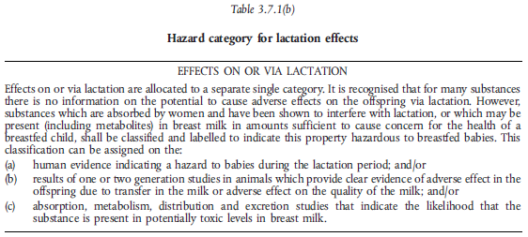
Reproductive toxicity
Effects on lactation

Slide 157
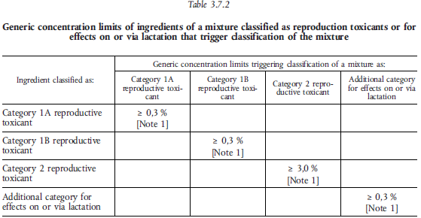
Reproductive toxicity
Mixtures classification

Slide 158
Reproductive toxicity
Label elements
Classification | Category 1A or Category 1B | Category 2 | Additional category for effects on or via lactation
GHS Pictograms |  |  | No pictogram
Signal word | Danger | Warning | Neo signal word
Hazard statement | H360: May damage fertility or the unborn child (state specific effect if known) (state route of exposure if it is conclusively proven that no other route of exposure cause the hazard) | H361: Suspected of damaging fertility or the unborn child (state specific effect if known) (state route of exposure if it is conclusively proven that no other route of exposure cause the hazard) | H362: May cause harm to breat-fed children
Precautionary statement Prevention | P201 P202 P281 | P201 P202 P281 | P201 P260 P263 P264 P270
Precautionary statement Response | P308 + P313 | P308 + P313 | P308 + P313
Precautionary statement Storage | P405 | P405
Precautionary statement Disposal | P501 | P501

Slide 159
Specific target organ toxicity – single exposure
Definitions and general considerations
Specific targe organ toxicity (single exposure) is defined as specific, non lethal target organ toxicity arising from a single exposure to a substance or mixture. All significant health effects that can impair function, both reversible and irreversible, immediate and/or delayed and not specifically addressed in the other hazard classes:
  a) Acute toxicity;
  b) Skin corrosion/irritation;
  c) Serious eye damage/eye irritation;
  d) Respiratory and skin sensitisation;
  e) Germ cell mutagenicity;
  f) Carcinogenicity;
  g) Reproductive toxicity;
  h) Aspiration hazard.

Slide 160
Specific target organ toxicity – single exposure
General considerations
This class includes substances and mixtures that exhibit specific target organ toxicity and which, accordingly, may harm the health of people exposed to them.
These adverse health effects produced by a single exposure include consistent and identifiable toxic effects in humans, or, in experimental animals, toxicologically significant changes which have affected the function of morphology of a tissue/organ, or have produced serious changes to the biochemistry or haematology of the organism, and these changes are relevant for human health.
Assesment shall take into consideration not only significant changes in a single organ or biological system but also generalised changes of a less severe nature involving several organs.
Specific target organ toxicity can occur by any route that is relevant for humans , i.e. principally oral, dermal or inhalation.

Slide 161
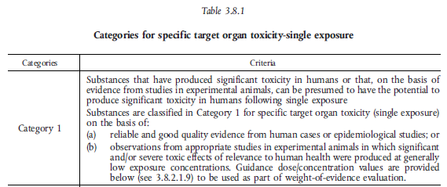
Specific target organ toxicity – single exposure
Classification

Slide 162
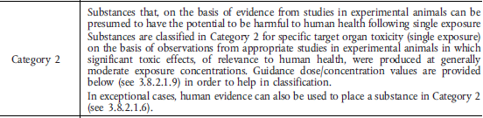
Specific target organ toxicity – single exposure
Classification

Slide 163
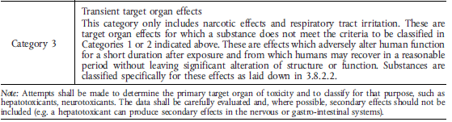
Specific target organ toxicity – single exposure
Classification

Slide 164
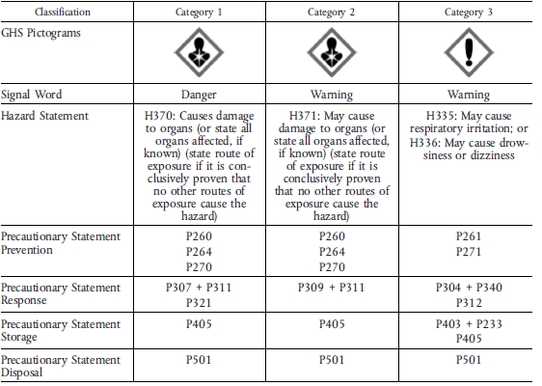
Specific target organ toxicity – single exposure
Label elements

Slide 165
Specific target organ toxicity – repeated exposure
Definitions and general considerations
Targe organ toxicity (repeated exposure) means specific, target organ toxicity arising from a repeated exposure to a substance or mixture. All significant health effects that can impair function, both reversible and irreversible, immediate and/or delayed and not specifically addressed in the other hazard classes.
This class includes substances and mixtures that exhibit specific target organ toxicity and which, accordingly, may harm the health of people exposed to them.
These adverse health effects include consistent and identifiable toxic effects in humans, or, in experimental animals, toxicologically significant changes which have affected the function of morphology of a tissue/organ, or have produced serious changes to the biochemistry or haematology of the organism, and these changes are relevant for human health.

Slide 166
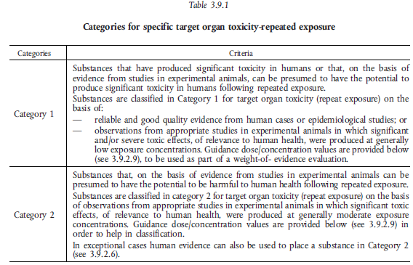

Slide 167
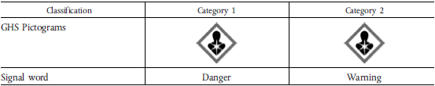
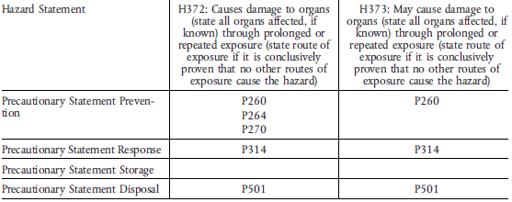
Specific target organ toxicity – repeated exposure
Label elements

Slide 168
Aspiration hazard
Definitions and general considerations
Aspiration means the entry of a liquid or solid substance or mixture directly through the oral or nasal cavity, or indirectly from vomiting, into the trachea and lower respiratory system.
Aspiration toxicity includes severe acute effects such as chemical pneumonia, varying degrees of pulmonary injuries or death following aspiration.
Aspiration of a substance or mixture can occur as it is vomited following ingestion . This has consequence for labelling, paerticularly where, due to acute toxicity, a raccomendation may be considered to induce vomiting after the ingestion.However, if the substance/mixture also present anaspiration toxicity hazard, the reccomendation to induce vomiting shall be modified.

Slide 169
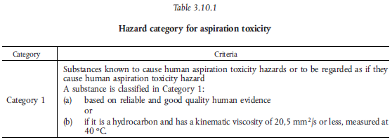
Aspiration hazard
Classification

Slide 170
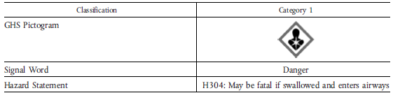
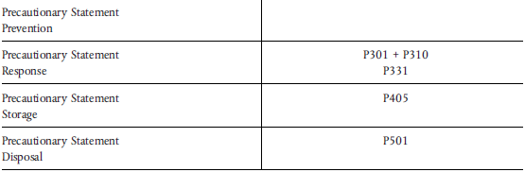
Aspiration hazard
Label elements

Slide 171
Safety in chemical lab
SAFETY DATA SHEET

Slide 172
Safety data sheet
1. (a) The person who is responsible for placing a chemical substance or preparation on the market, whether the manufacturer, importer or distributor, shall supply the recipient, who is a professional user of the substance or preparation, with a safety data sheet containing the information set out in Article 3 and the Annex to this Directive, if the substance or preparation is classified as dangerous according to Directive 67/548/EEC or European Parliament and Council Directive 1999/45/EC (*).
(b) Any person who is responsible for placing a preparation on the market, whether the manufacturer, importer or distributor, shall supply, on request of a professional user, a safety data sheet providing proportionate information as set out in Article 3 and the Annex to this Directive, if the preparation is not classified as dangerous according to Articles 5, 6 and 7 of Directive 1999/45/EC, but the preparation contains in an individual concentration of ≥ 1 % by weight for non-gaseous preparations and ≥ 0,2 % by volume for gaseous preparations at least one substance posing health or environmental hazards, or one substance for which there are Community workplace exposure limits.

Slide 173
Safety data sheet
DSD/DPD and REACH
Safety data sheet has been changed with the adoption of the REACH regulation.
DSD and DPD introduced tha safety data sheet composed by 16 different voices;
The REACH regulation has expanded the cases in which a safety data sheet have to be provided and has made changes to its content.

Slide 174
Safety data sheet
The supplier of a substance or a mixture shall provide the recipient of the substance or mixture with a safety data sheet :
(a) where a substance or mixture meets the criteria for classification as hazardous in accordance with Regulation (EC) No 1272/2008; or;
(b) where a substance is persistent, bioaccumulative and toxic or very persistent and very bioaccumulative in accordance with the criteria set out in Annex XIII; or
(c) where a substance is included in the list established in accordance with Article 59(1) for reasons other than those referred to in points (a) and (b):

Slide 175
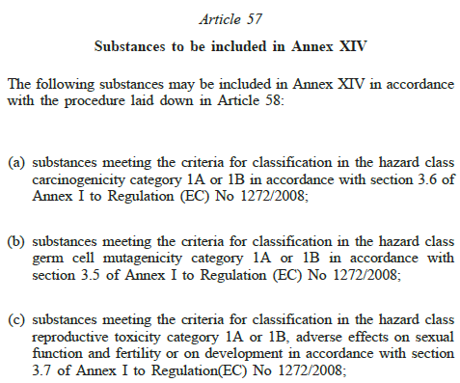
Safety data sheet

Slide 176
Safety data sheet content
The procedures for drafting the safety data sheets were defined into the D.M. 7 september 2002 which transposed the Directive 2001/58/CE
Now is in force the REACH regulation1907/2006/CE.
Annex II to the Regulations contains a guide to the drafting of safety sheets.

Slide 177
Safety data sheet
The Safety Data Sheet for hazardous substances and preparations must include the following mandatory entries:
1 Identification of the substance/mixture and of the company/undertaking
2 Hazards identification
3 Composition/information on ingredients
4 First aid measures
5 Firefighting measures
6 Accidental release measures
7 Handling and storage
8 Exposure controls/personal protection
9 Physical and chemical properties
10 Stability and reactivity
11 Toxicological informations
12 Ecological informations
13 Disposal considerations
14 Transport informations
15 Regulatory informations
16 Other informations

Slide 178
Safety in Chemical Lab
TECHNICAL GASES

Slide 179
Use of technical gases
In scientific laboratories, gaseous reagents (technical gases) are widely used. They are ususally stored in cylinders which can be installed directly in the laboratory or placed outsideIn this latter case, the gases are transported by special pipe lines.
Most frequent use of technical gases
  Synthesis reagent;
  Inert gas;
  Chromatoghraphy carrier gas;
  Flames

Slide 180
Compressed gas hazards
Hazard | Prevention measurements
Accidental removal of the cylinder valve | Keep the cylinder with the cap on, when not in use. Keep the cylinder fixed to the wall Move the cylinder exclusively with the special trolley
Asphyxiation | Check that valves and regulators are not leaking.
High pressure, reactive, flammable, cryogenic or toxic gas escape | Prevent the circumstances in which the valve or regulator may break. Be prepared to face a gas leak.
Valve or regulator malfunction | Store in ventilated areas Periodically replace gaskets if used. Do not grease, lubricate or use teflon tape. Check for foreign damages and / or materials.

Slide 181
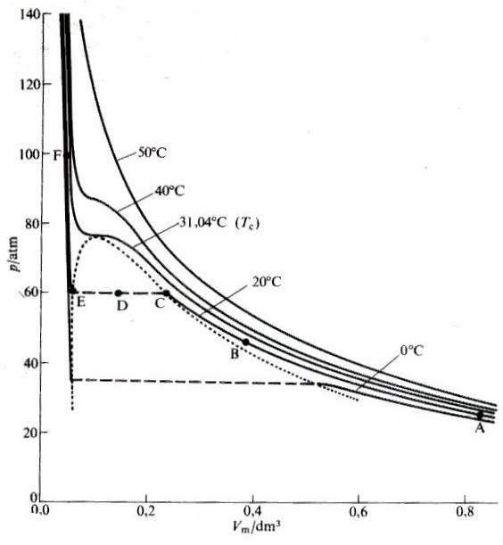
Real gases
Critical temperature (T_{c}): The temperature below which a gas may liquefy increasing the pressure

Slide 182
Critical temperature
Gas
Critical temperature
K
°C
N₂‏
126,3
-146,9
O₂‏
154,8
-118,4
Ar‏
150,7
-122,5
CO₂‏
304,2
31,1
Ne‏
44,4
-228,8
He‏
5,21
-267,9
CH₄
191,1
-82,1
Kr
209,4
-63,8
H₂
33,2
-240,0
CH≡CH‏
308,7
35,5
NH₃‏
647,4
374,3
CO‏
133,2
-140,0

Slide 183
Gas density
Gas
Relative density
N₂‏
0,97
O₂‏
1,10
Ar‏
1,38
CO₂‏
1,52
Ne‏
0,70
He‏
0,14
CH₄
0,55
Kr‏
2,89
H₂
0,07
CH≡CH‏
0,90
NH₃‏
0,59
CO‏
0,97

Slide 184
Classification of technical gases
Technical gases are classified according to their properties, into:
  Compressed gases
  Liquified gases
  Highly refrigerated liquified gases
  Dissolved gases

Slide 185
Compressed gases
Gases with a critical temperature below 263 K (-10 °C)‏
They can therefore not be liquefied increasing only the pressure
They are contained in cylinders as high pressure gas (typically around 200 atm)
The filling of the cylinders is done controlling the pressure
Examples: nitrogen, oxigen, noble gases, hydrogen

Slide 186
Liquified gases
Gases with critical temperature ≥ 263 K(-10 °C).
Above a certain pressure (P_{C}), at room temperature, they start to liquefy.
The cylinder contains the liquid in equilibrium with the gas at a pressure given by the vapor pressure at that temperature
The cylinder is filled checking the weight
When the cylinder is full, the liquid phase occupy more or less 80% of the total volume
Examples: carbon dioxide, ammonia

Slide 187
Highly refrigerated liquefied gases
They are gases mantained at temperature well below 0 °C
They have to be transported in special, thermally isolated, container (Dewar)
Examples: liquid oxigen, liquid argon and liquid nitrogen

Slide 188
Dissolved gases
They are gaseous substances that require to be dissolved in a solvent to be stabilized when compreessed
    Example:
    Acetylene is transported into a solution of acetone absorbed on a very light porous support (90% porosity)

Slide 189
Gas classification according to their properties
Oxidising: oxigen and pressurized air, nitrous oxide,etc.
Flammable: methane, acetylene, ethylene, propane, butane, hydrogen, etc.
Inert: helium, neon, argon, nitrogen, etc.
Toxic: carbon monoxide, cyanogen, chlorine, ammonia, etc.
Corrosive: chlorine, ammonia etc.

Slide 190
Prevention
The main prevention measures related to gas use are:
  Check and eventually eliminate leaks
  Ventilate the laboratory
  Check the gas concentration in air
  Handle with care the cylinder

Slide 191
Leakages
Accidental release of gas into the atmosphere.
A leakage can be caused by:
  Sealing failure of pipe or container connections
  Gas out of a valve, a tap, a barrel or a bottle left open
The presence of a leakage can be controlled by putting some water and soap or a 50% glycerol solution (more suitable in case of freezing) at the point where gas leak is suspected.

Slide 192
Ventilation
The laboratory ventilation is intended to provide the substitution of the ambient air to dilute the gas making it no longer (or less) dangerous.
The ventilation can be natural or mechanical (forced)‏
Natural ventilation is used in warehouse
Forced ventilation is used in the laboratory

Slide 193
Forced ventilation
When making a ventilation system in a room where gas is to be used, the following parameters should be considered :
  Extraction, from below, of the air to be renewed
  Take fresh air from a zone far away from that where it is expelled
  The extraction capacity must be such as to create in the laboratory a pression lower than outside
  The extraction capacity must be adequate to the expected gas escape rate

Slide 194
Checking the gas content
In rooms where there is the possibility of explosive mixtures formation, or escape of toxic gases, gas detectors must be installed at the appropriate height

Slide 195
Inerting
It is the operation of adding an inert gas to an explosive/flammable mixture in order to reduce the oxygen content and bring it below the explosion/flammability limit
This procedure is used for:
  containers and/or pipes washing,
  the extraction of flammable solvents by distillation or centrifugation
  to prevent the contact between flammable substances and air

Slide 196
Flammable gases
Leakage check:
  Sensor installation,
  Odorous substances;
Ventilation
Removal of ignition sources, prohibition of ignition of flames and smoke
Specific electrical equipment

Slide 197
Inert gases
Rapid release of inert gases can reduce or eliminate the presence of oxygen in the environment where it is taking place.
The air we breathe contains 21% oxygen. If this percentage decreases for a rapid release of inert gases, the environment should immediately be evacuated as the risk of asphyxia is very high.

Slide 198
Inert gases hazards
You are in danger of life:
  After three weeks whithout anything to eat
  After three days withiut anything to drink
  After three minutes of apnea
  After three inspiration of gases not containing oxigen
Underoxygenation may be produced by:
  Evaporation of a liquified gas: 1 liter of N₂ produces 705 liter of gas
  Pipes or gas tanks exhausts

Slide 199
Underoxygenation
HUMAN SENSES DO NOT DETECT UNDEROXYGENATION
21% normal oxygen concentration in air
19% yawn, fatigue
14% rapid pulses, malaise, dizziness
10% nausea, rapid fainting
8% coma after 40 s, respiratory arrest, death
0% coma and respiratory arrest after three inspirations

Slide 200
Underoxygenation
The O2 content in an environment can only be detected by suitable tools
Underoxygenation can lead to attenuation of attention, a deformation of judgment and, in a short time, brain injury
Loss of knowledge and death occur without any warning or alarm
Symptoms such as drowsiness, fatigue, and evaluation errors can be masked by a state of euphoria that causes a false sense of security and well-being

Slide 201
Underoxygenation hazard
The risk of underoxygenation is present in the following cases :
  Closed spaces: tunnels, cobblestones, reservoirs, etc.
  Semiclosed spaces: internal parts of buildings, laboratories, under machinery pit, etc.
  Gas leakage: from a container, a pipeline, a valve, a regulator, etc.
  Cryogenic gas evaporation

Slide 202
Inert gas hazard prevention
Precautions
  If you experience a gas leak
  If you see cold vapors (air humidity condenses)
  If you, or a colleague have a malaise
ASSESS THE RISK AND IF YOU HAVE A DOUBT
GIVE THE ALARMA AND EVACUATE THE DANGEROUS ZONE
In some departments, there are lockers with self-contained breathing apparatus.
The gas masks are not effective in case of underoxygenated air

Slide 203
Inert gases hazards prevention
The risk is present as soon as the percentage of oxygen in the air falls below 17%
Avoid leakage into the environment
Bring ventings to the outside
Indicate the possible presence of underoxygenated atmospheres
Sensors

Slide 204
Toxic gases precautions
Work under chemical hood
Ventilation
Monitoring
Suitable respiratory equipment
Personal protective equipment: googles, gloves, hermetic suits

Slide 205
Gas containers
Gas containers are containers intended to contain fluids at a pressure other than atmospheric pressure. They can be:
  Steam generators: they convert a liquid into its steam to be used outside the generator. They are always fixed.
  Steam or gas containers: they can be fixed or for transport. They are filled with the fluid to be used in locations other than the filling one.

Slide 206
Fluids
Pressurized vessels may contain fluids :
  Compressed
  Liquefied
  Dissolved
  Highly refrigerated

Slide 207
Cylinders
The cylinders are pressure vessels, generally in steel alloy, designed to contain and transport gases :
    Compressed
    Dissolved
    Liquefied
The cylinders have to:
    Ensure an airtight seal
    Resist to pressure changes
    Resist to the mechanical and chemical properties of the gas contained

Slide 208
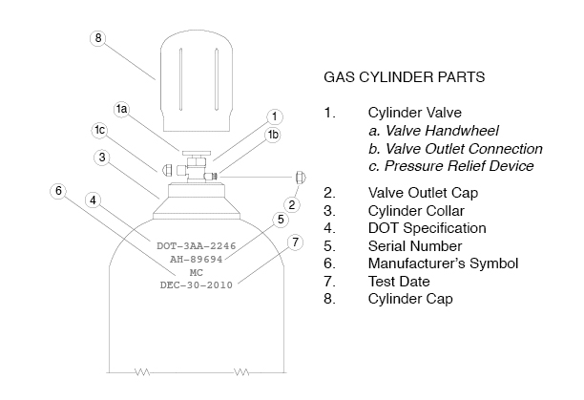
Cylinder elements

Slide 209
Cylinder identification
The cylinders must bear the following data :
  Punching made at the time of construction
  Operating pressure at 15 °C (depending on the filling condition)‏
  Hydraulic test pressure
  Capacity in liters
  Material type
  Contained gas
  Periodicity of the test

Slide 210
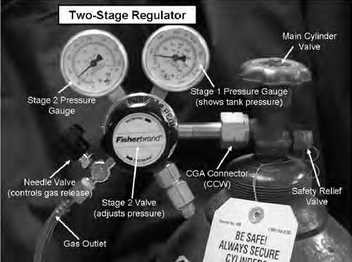
Pressure regulators
By opening the tap applied to the cylinder, the gas exits the internal pressure;
Usually, therefore, it is installed a pressure regulator, often a two-stage regulator

Slide 211
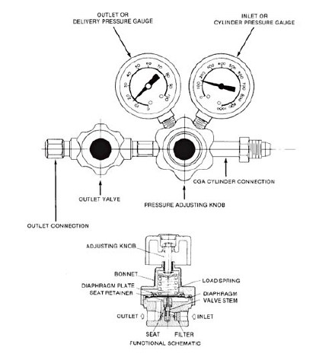

Slide 212
Two-stage pressure regulator
The two-stage pressure regulator are used to lower the pressure of the gas contained in the cylinder at high pressure.
They are made of brass or stainless steel and are equipped with two pressure gauges (the first for the internal pressure and the second for the output pressure)
The output pressure regulation is obtained with a screw knob and sometime can be present an output flow control valve. The versions with a flowmeter have a fixed pressure setting: only the flow (flow rate) of the output gas can be varied.
The connections of the regulators with the cylinder valve are all regulated by UNI standards, and are specially designed to withstand very high pressures. It is strictly forbidden to insert any other kind of connection between the cylinder valve and the pressure regulator.

Slide 213
One-stage pressure regulator
The one-staeg pressure regulators are used to lower and controll the pressure and the gas flow in a dostribution pipeline.
They are made of brass or stainless steel. They have a single pressure gauge (displaying the output pressure from the gearbox), they have the possibility to regulate the output pressure, and they can have an output flow shut-off valve, which can be either ball or micrometer (depending on the models).
The versions with a flowmeter in place (or in addition) of the pressure gauge can vary and also control the flow (flow rate) of the output gas.
The connections of the second stage pressure regulators are normally GAS or NPT threads, so they are connection normally present in the market. However, be very careful about the working pressure of the pressure regulator, before inserting any type of fitting.

Slide 214


Pressure regulator
Two-stages regulatore
One-stage regulator
Pressure regulators and associated equipment are specific to each type of gas and should not be exchanged.

Slide 215
Degree of gas purity
The impurity content is mostly expressed in ppm, ppb or ppt.
Commercially, purity is indicated by a two-digit symbol. For example:
ARGON N 56
  The first digit indicates the number of 9
  The second digit indicates the first digit after the 9
  In this case Ar purity is 99,9996%, or the impurity content is 4 ppm .

Slide 216
Color code
To facilitate their identification, the cylinders have a characteristic coloration depending on the content
The color of the body of the cylinder is decided by the manufacturer while the cylinder collar must comply with the conventional colors established by the norm UNI EN 1089 - 3, transposed with D.M. 7 January 1999
The cylinder must also have be labeled with the characteristic label of the substance and the GHS pictograms, as any other packaging of chemicals.

Slide 217
Color code
Specific gases
Acetylene: RUSSET
Oxigen: WHITE
Nitrous oxide: BLUE
Argon: DARK GREEN
Nitrogen: BLACK
Carbon dioxide: GREY
Helium: BROWN

Slide 218
Color code according to the hazard
With the exception of specific gases, all gas and gas mixtures must be identified by a color coding that indicates the properties of the contents in accordance with the hazard labels
Toxico and/or corrosive: YELLOW
Flammable: RED
Oxidising: LIGHT BLUE
Inert: BRIGHT GREEN

Slide 219
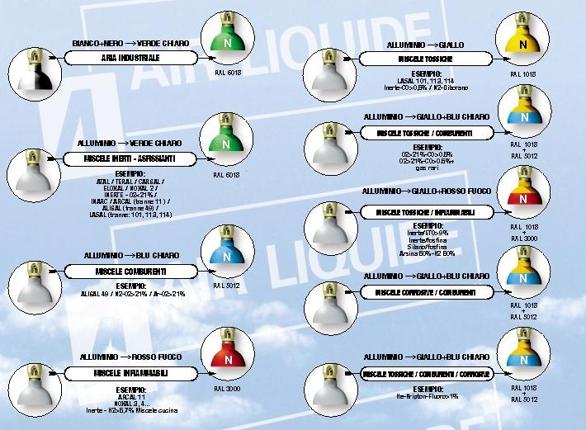
Colorazione bombole miscele

Slide 220
Risk assesment (1)‏
The risks associated with the use of cylinders are:
  Weight of containers: this is the main cause of a cylinder injury. A full tank can weigh up to 100 kg.
  When handling and transporting the cylinders, gloves must be used and handling must be carried out with special trolleys. Steel toe-boot should be used for extended movements

Slide 221
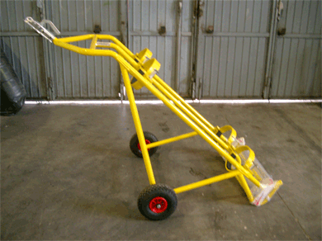

Slide 222
Risk assesment (2)‏
Cylinder explosion: The cylinders can burst when the internal pressure rises at high temperatures. This risk is very strong in the event of a fire.
Valve fitting: Various fittings can be mounted on different cylinders. Care should be taken when connecting equipment to make incorrect connections.

Slide 223
Risk assesment (3)‏
Improper use of containers: It is dangerous to use gas containers, full or empty, for uses other than those for which they were built.
Inventories: The cylinders must be kept in special, dry, cool and well-ventilated rooms with controlled access. They can be kept in the labs only in exceptional cases. In any case, they must be secured to a fixed stand.

Slide 224
Precautions in the use of cylinders
Never move a cylinder without the cap properly inserted
Do not use the cylinder cap sa a gripping point
Do not leave the cylinders under hoist or other heavy objects whose movements can bump or fall on them
Do not transport the cylinders by rolling them on the floor
Do not use cylinders such as rollers, supports, anvils or as source of electric arc
Do not subject the cylinders to violent mechanical shocks
Do not use cylinders after the expiration period
Never lubricate the parts to be connected with oils, greases etc.

Slide 225
Cryogenics
Some gaseous substances at room temperature, are liquefied at high pressure to obtain cryogenic liquids.
The gases generally used to produce cryogenic liquids are nitrogen, argon, helium and oxygen.
Substance | Boiling point (K)
Nitrogen | 77
Argon | 87
Helium | 4
Oxygen | 90

Slide 226
Cryogenics characteristics and hazards
Potential hazards deriving by cryogenics manipulations are due to the following characteristics:
  are extremely cold (helium is the coldest),
  very small amounts of liquid are converted into large volumes of gas (eg 1 liter of liquid nitrogen expands under standard conditions to about 700 liters of gas)

Slide 227
Risks involved in cryogenics use
Contact of body parts with cryogenic substance. Freezing injuries can result in permanent damage.
Reduction of the amount of oxygen in ambient air and consequent risk of asphyxiation. These risks are higher than those with compressed gases.
Explosion if the cryogenic is contained in a closed vessel.

Slide 228
Cryogenics
Freeze injury
Any contact of a cryogenic with the skin or eyes causes damage due to tissues freezing.
The skin that comes into contact with a strongly cooled material binds to it and the removal can be very painful.
The frozen tissue at first does not hurt, but when it warms up the pain can be very strong and there is the risk of infections, edema and blood clots

Slide 229
Cryogenics explosions
The evaporation of a cryogenic leads to the formation of many volumes of gas. For this reason, cryogenics should never be sealed in containers that do not withstand the great pressures that would form when they evaporated..
Cryogenics can cause the liquefaction of higher boiling gases in sealed containers that are cooled, which then explode when the container reaches the boiling point of the gas. A typical case is that of oxygen liquefaction (90 K) at the liquid nitrogen temperature (77 K).
In this case we are presence of a BLEVE (Boiling Liquid Expanding Vapor Explosion) without subsequent fire.

Slide 230
Cryogenics asphyxia
The spill of a cryogenic liquid with subsequent (rapid) evaporation can lead to a decrease in the percentage of oxygen with a serious risk of asphyxia
One liter of cryogenic can produce 600-1200 liters of gas.
Cryogenics should not be used in subsoil, basement, lifts and in confined environments in general.
Oxygen sensors are often installed where cryogenics are used.

Slide 231
Cryogenics
Prevention measures
Avoid accidental contact with cryogenic liquids or evaporated gases that are still at very low temperatures, as it can cause burns as serious as those caused by high temperature.
Keep the cryogenic liquid containers in well-ventilated areas as they may cause asphyxiation, depending on the room volume.
Depending on the size of the room and the amount of cryogenic gas stored it may be necessary to set up an oxygen level sensor, connected to an alarm system

Slide 232
Cryogenics
Prevention measures
Do not use elevators.
Cryogenic transfer operations must be made by operators appropriately informed on the potential risks associated with its manipulation.
During the tansfer operations:
  wear suitable protective equipment such as cold resistant gloves and, goggles
  avoid any direct contact with cryogenic substances,
  keep the ventilation system active or open the openings to the outside

